Slide 1
Team Lead User Guidance
Ecolomed Learning Management System (LMS)

Slide 2
Objectives
Team Lead Capabilities and Information
Managing Employee Access/Information
Adding an Employee
Team Structure/Course Assignments & Fundamentals
Deactivating an Employee
Username/Password Management
Compliance Reports

Slide 3
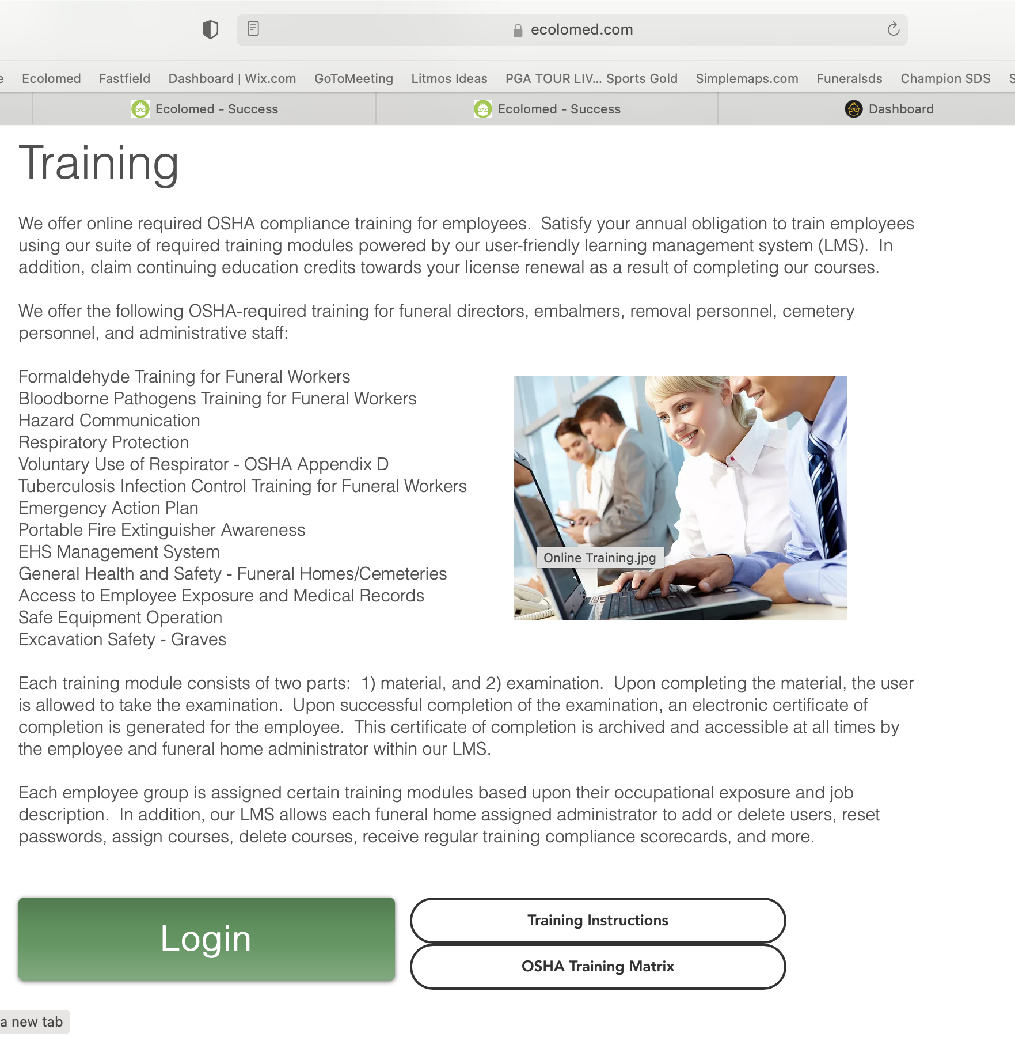
Login
Access your training via our website at www.ecolome.com/training
Click on the green Login button
Accessing your training via our website is strongly recommended as opposed to email hyperlinks
Email hyperlinks expire after 24 hours for security purposes

Slide 4
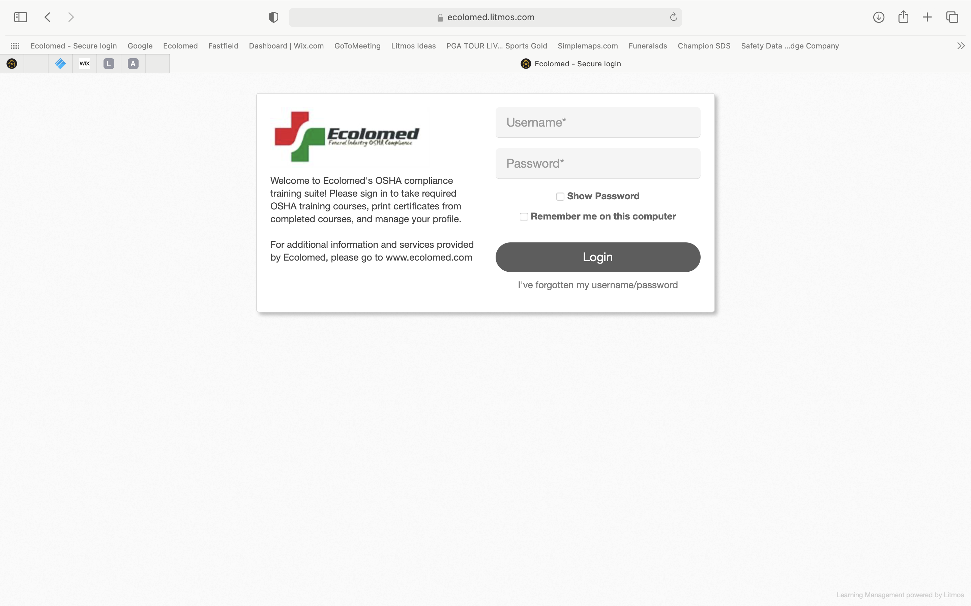

Slide 5
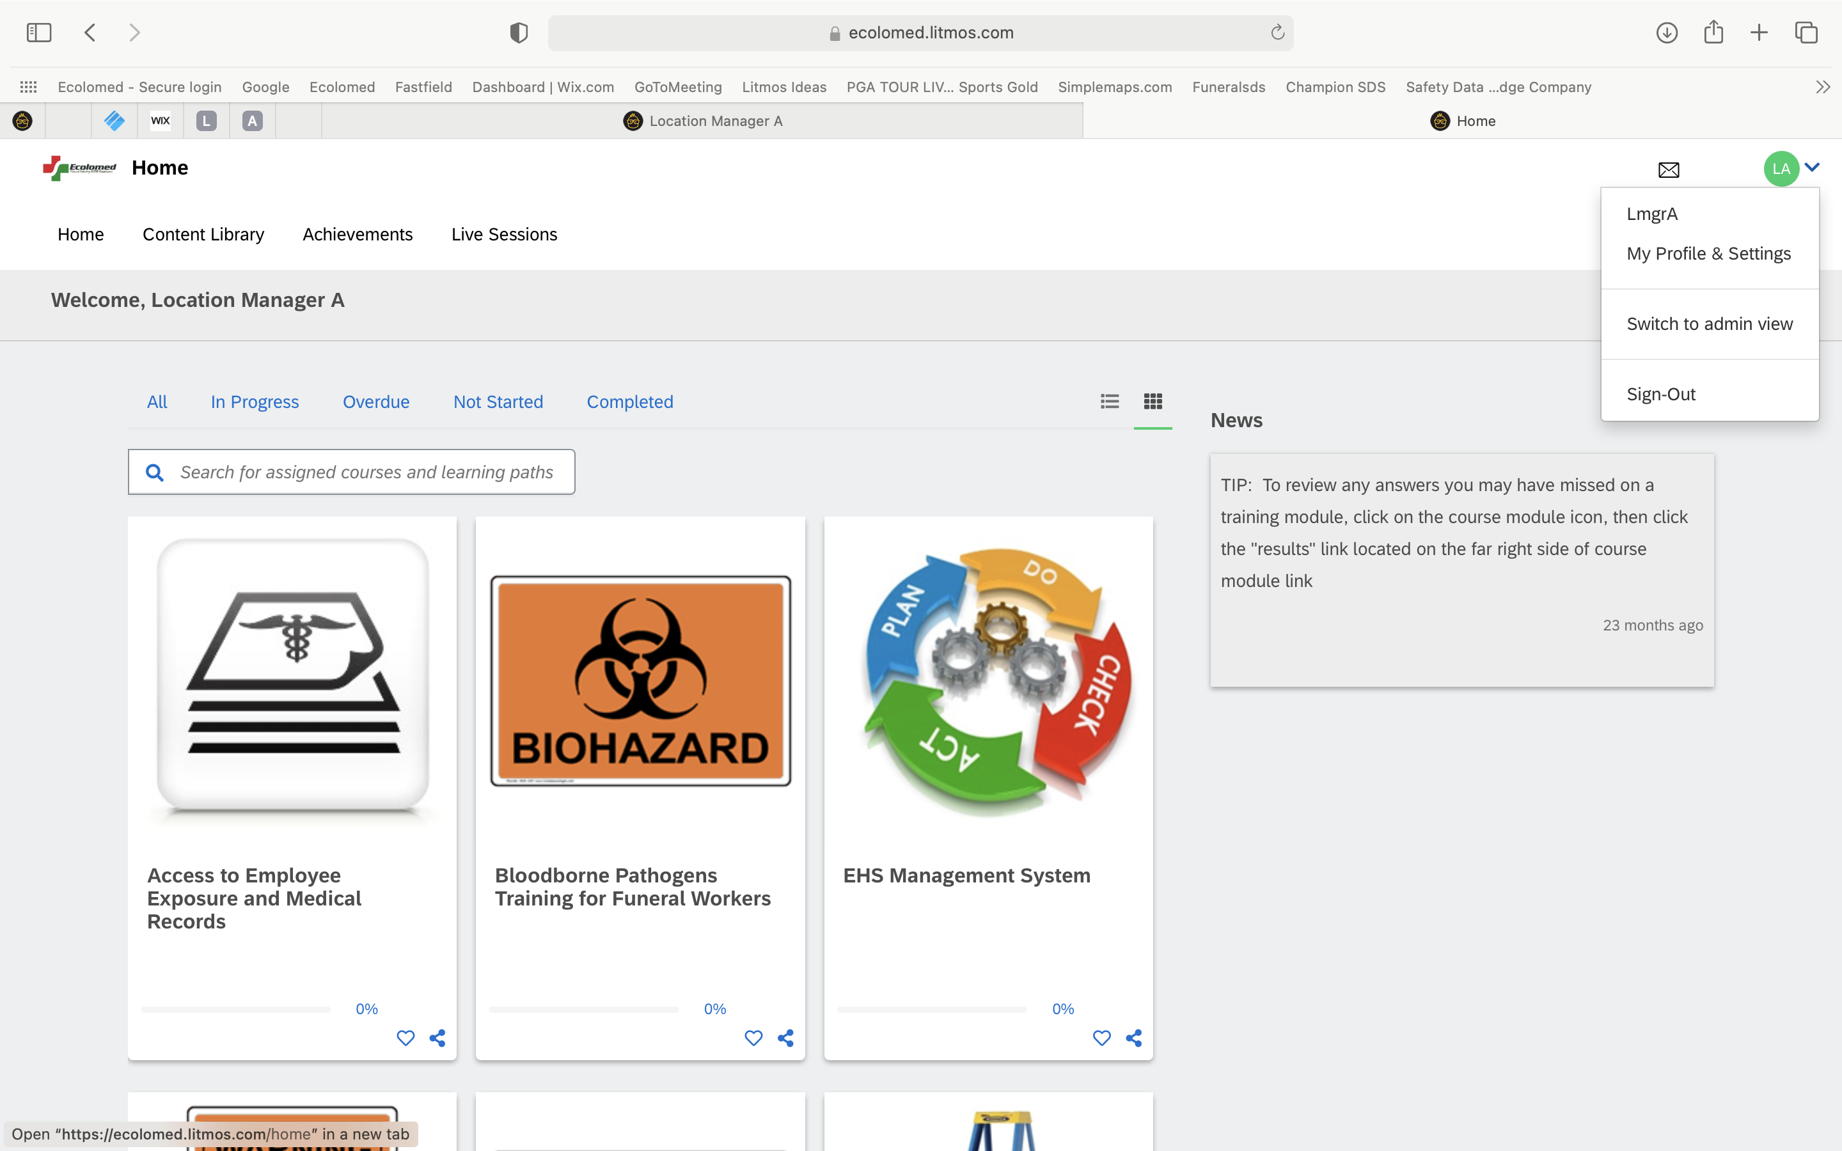
Learner vs. Admin View
Upon initial login, you will be in the “Learner View”
Learner View is where all of your individual course assignments are located
This is the view all of your employees have as “Learners” (yourself included)
Click on your initials button in upper right corner of page to access drop down and confirm what view you are in i.e. either Learner or Admin View
Click on “Switch to Admin View” to switch views

Slide 6
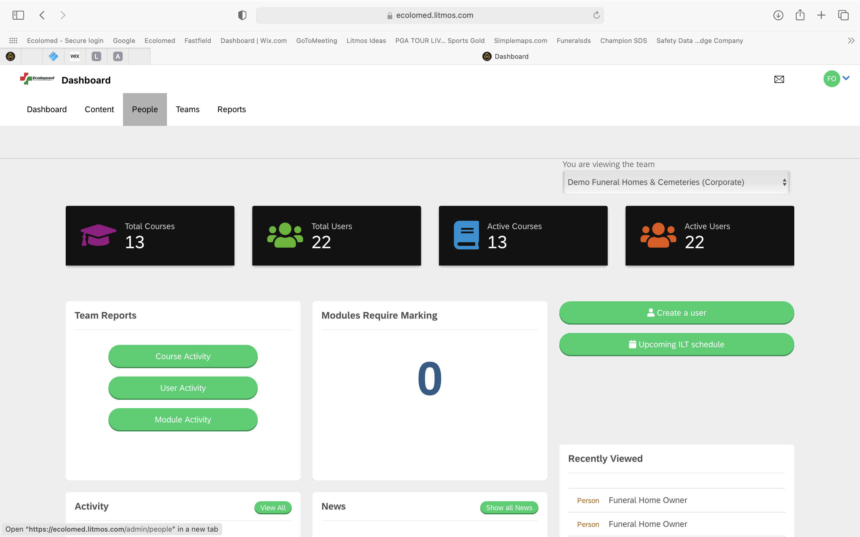
Admin View
The Admin View provides you the following:
Dashboard
Employee Listing and Training Completion Information
Courses Assigned
Reporting Tools

Slide 7
Adding an Employee
To add an employee, the following information needs to be gathered:
First and Last Name
Email
Company
Telephone #
Job Responsibilities Information (for course training assignment)

Slide 8
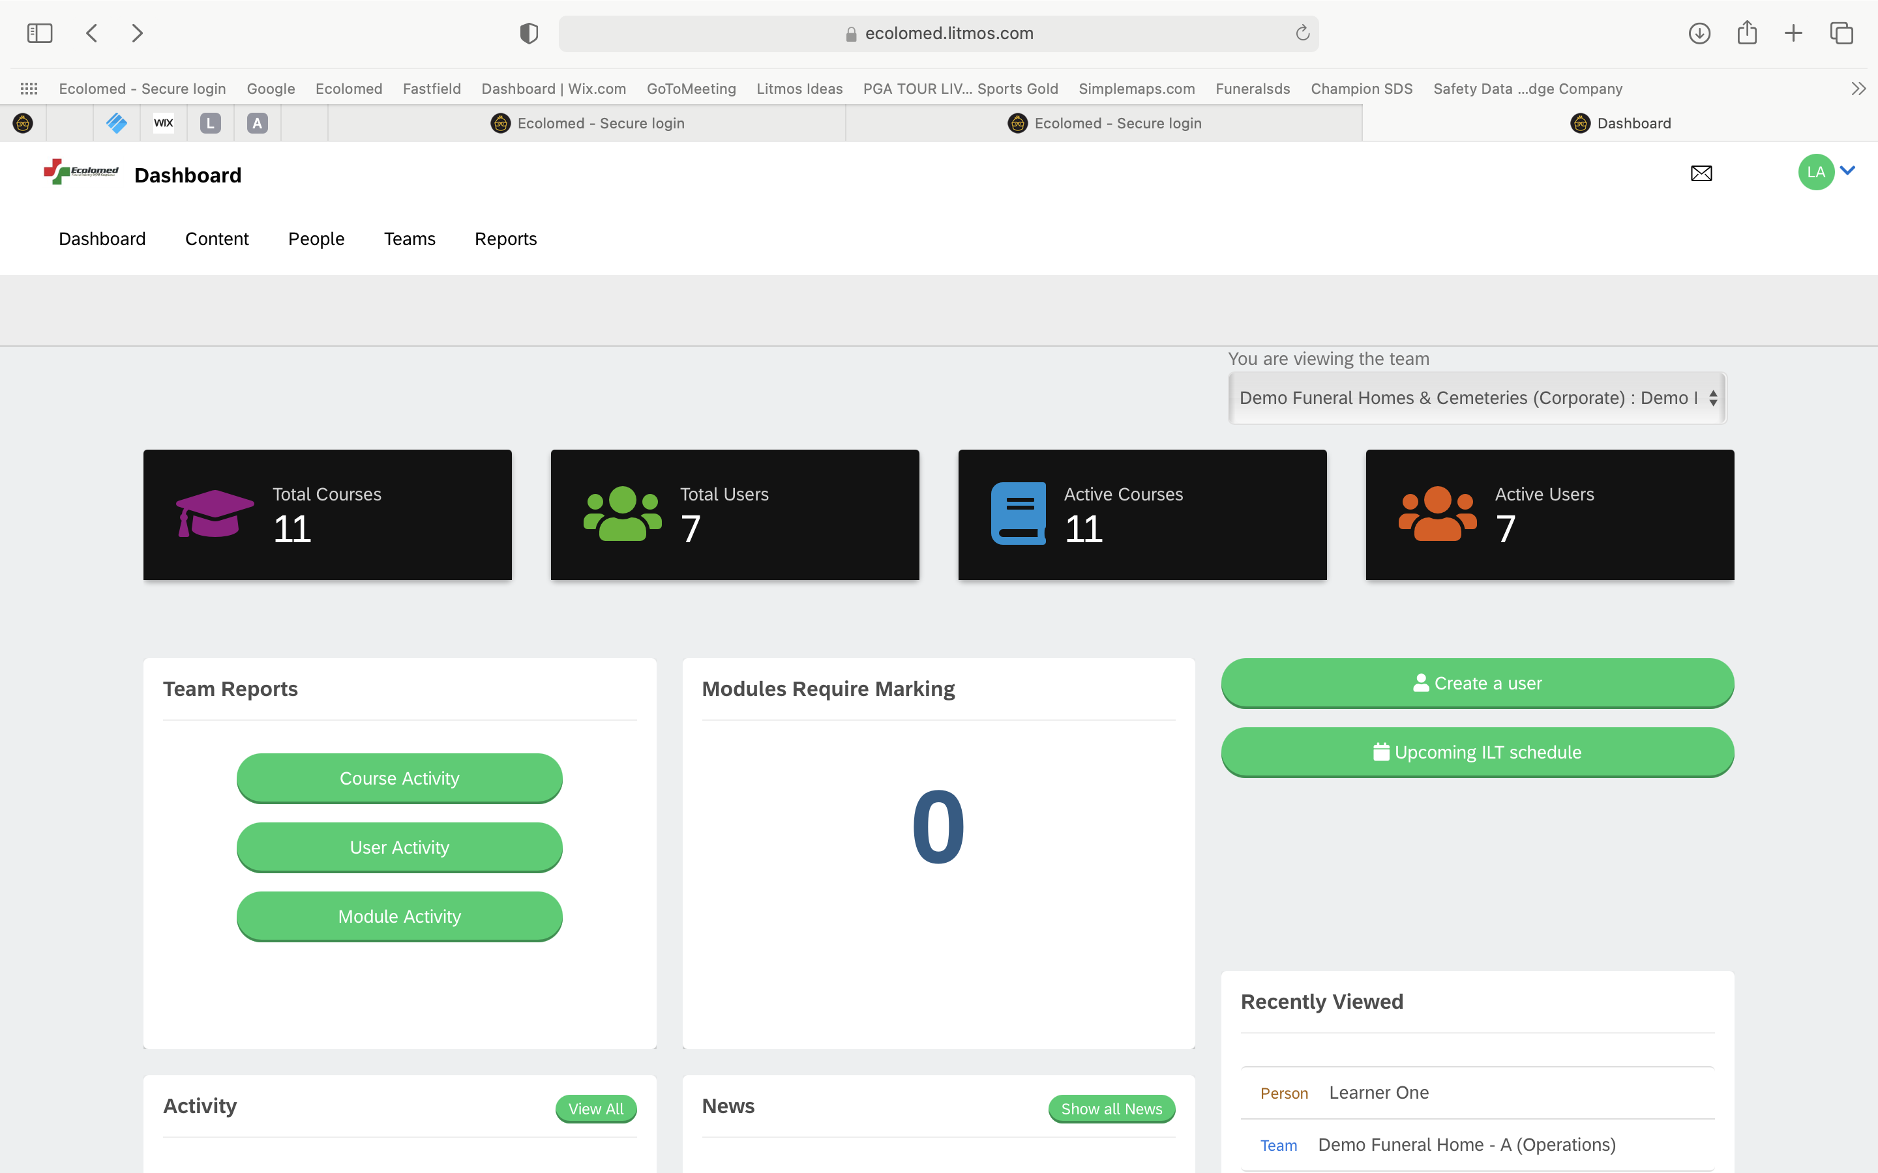
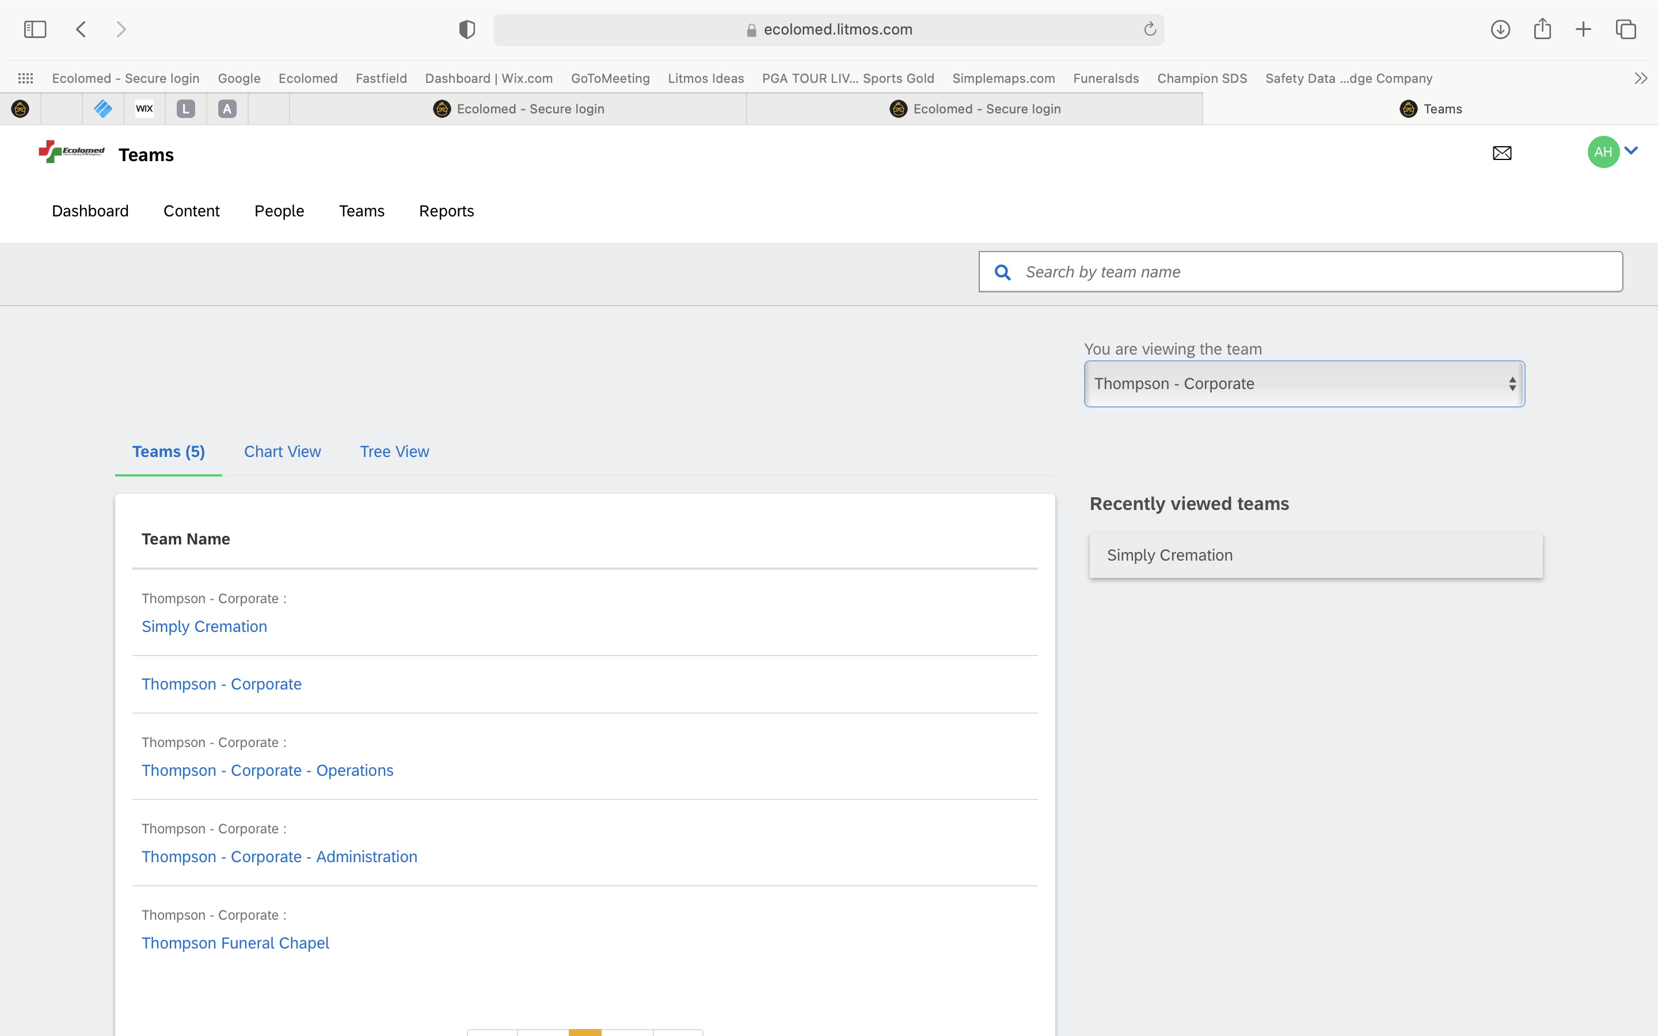
Adding an Employee
Click on “Teams”
You will see the established Team Structure

Slide 9
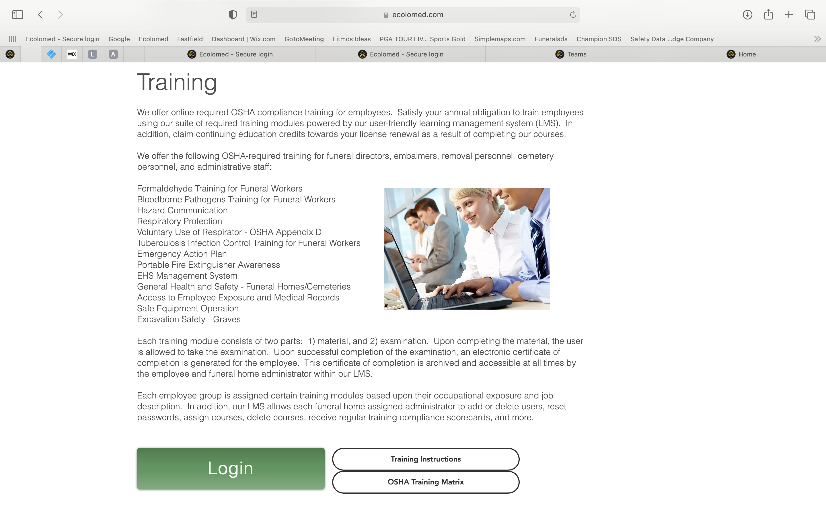
OSHA Training Matrix
All new employees must be added to one or more of the following types of “sub-teams”:
Operations
Administrative
Cemetery
Each of these sub-teams has specific compliance courses that get auto-assigned to employees when they get added
OSHA Training Matrix

Slide 10
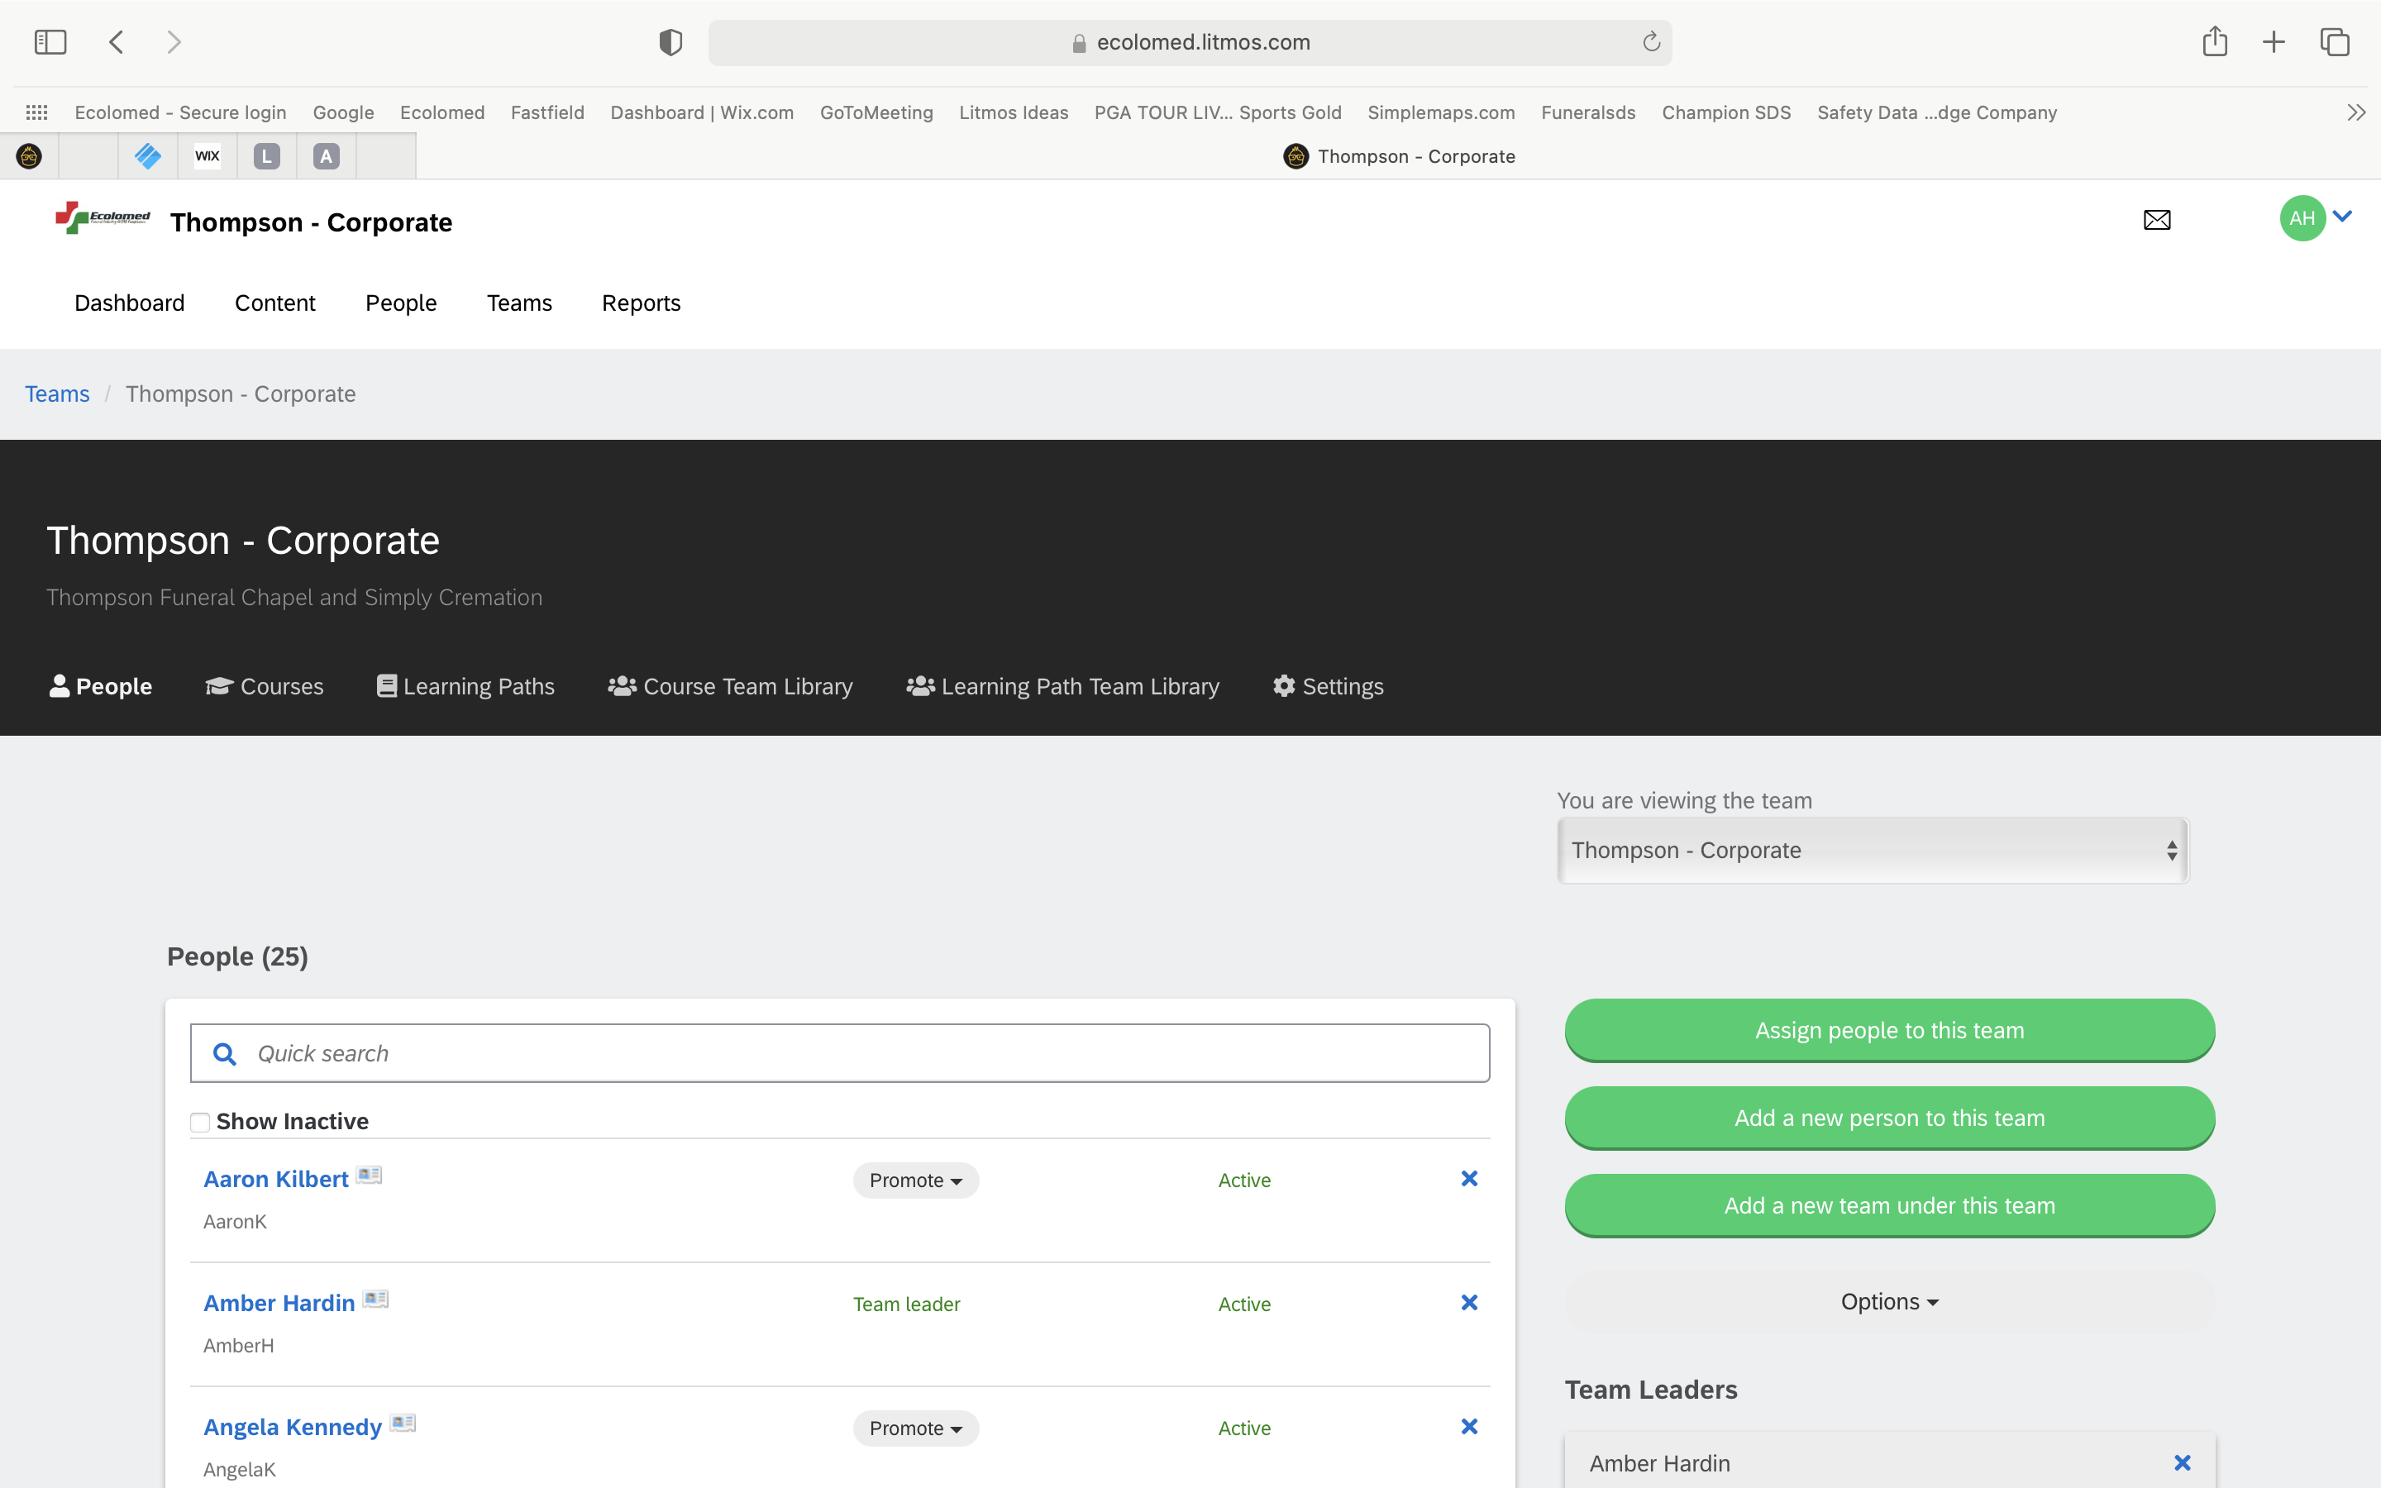
Adding an Employee
Click on a Team
Click on “Add a New Person to this Team”

Slide 11
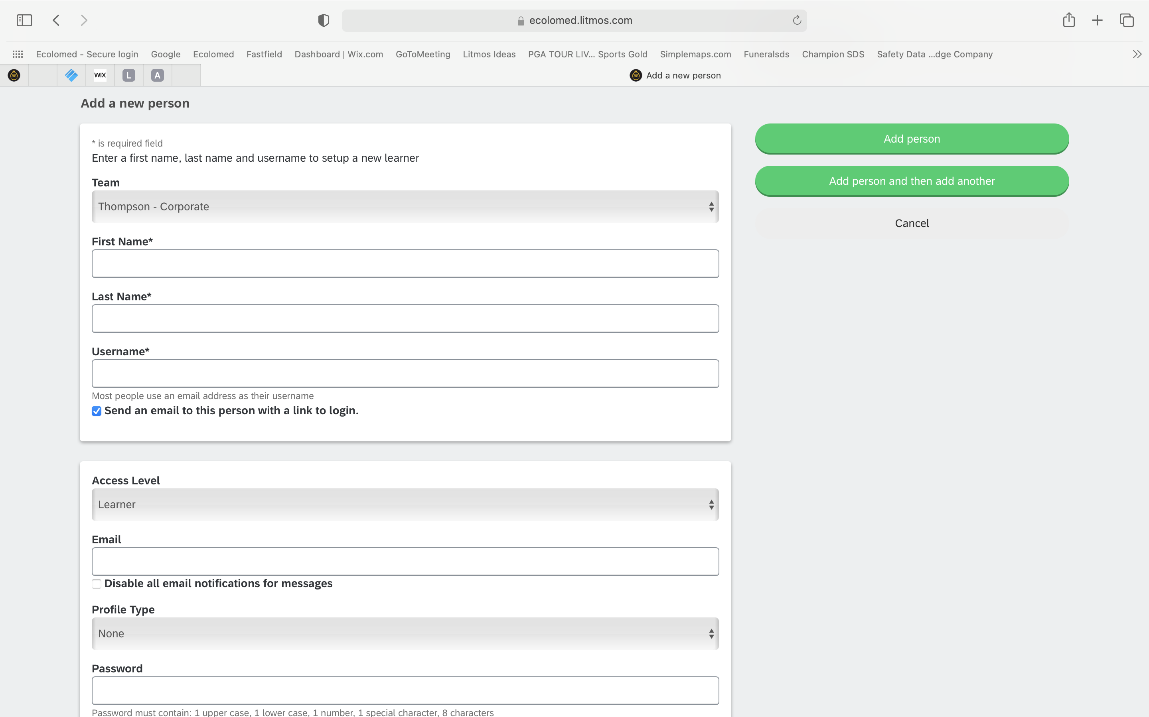
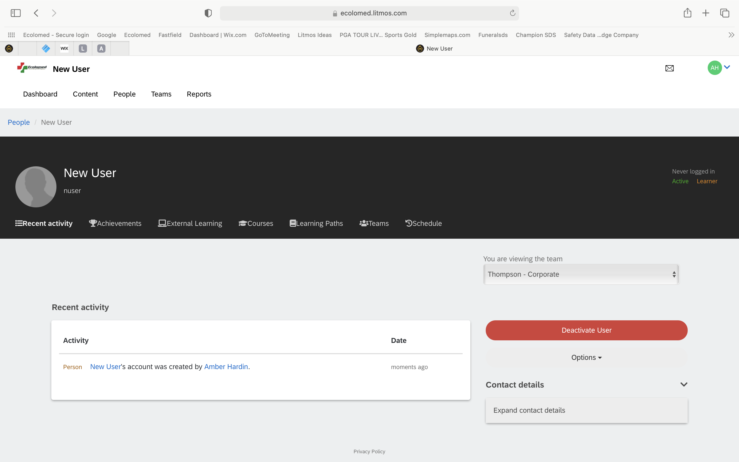
Adding an Employee
Input the required information for the new employee, then click “Add Person”
You will be taken next to their Profile
Next click on “Teams” to see the team you just added the employee to and to add them to additional necessary teams

Slide 12
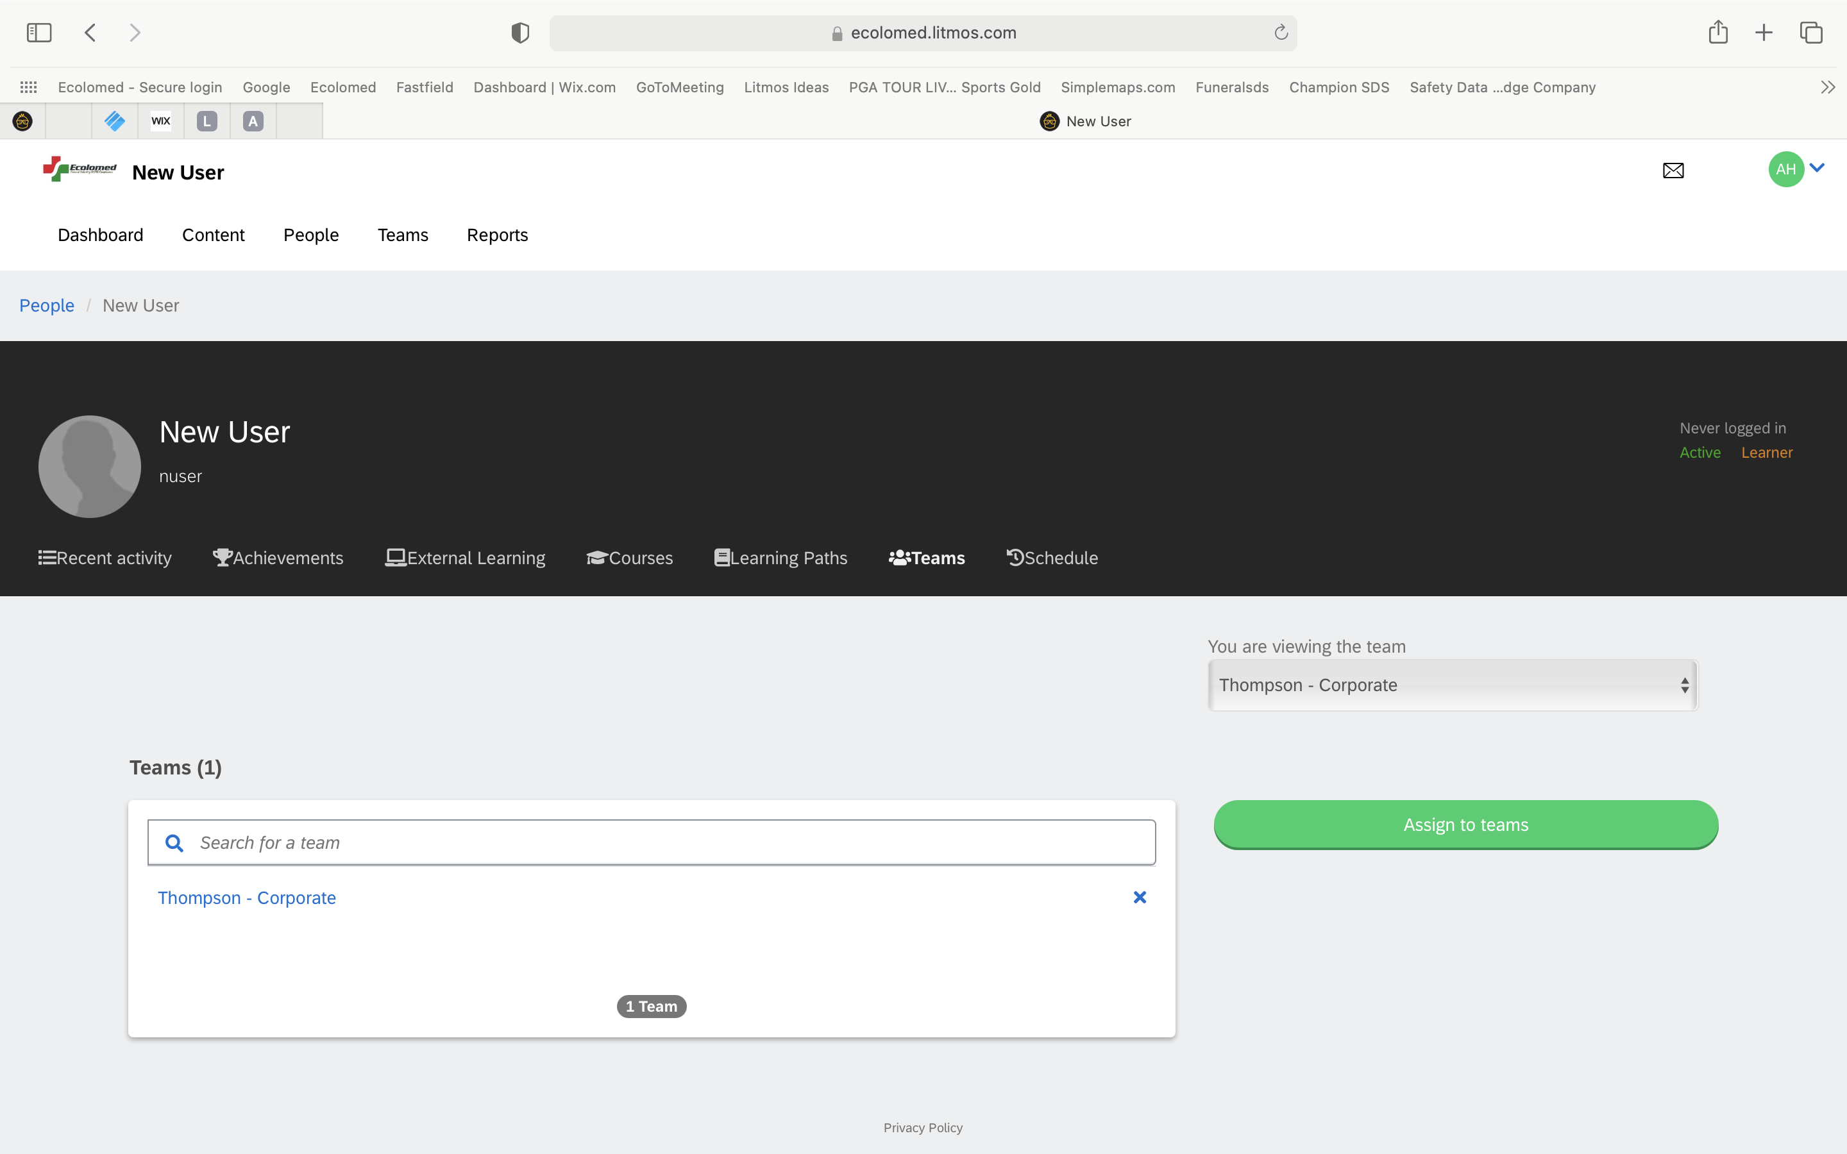
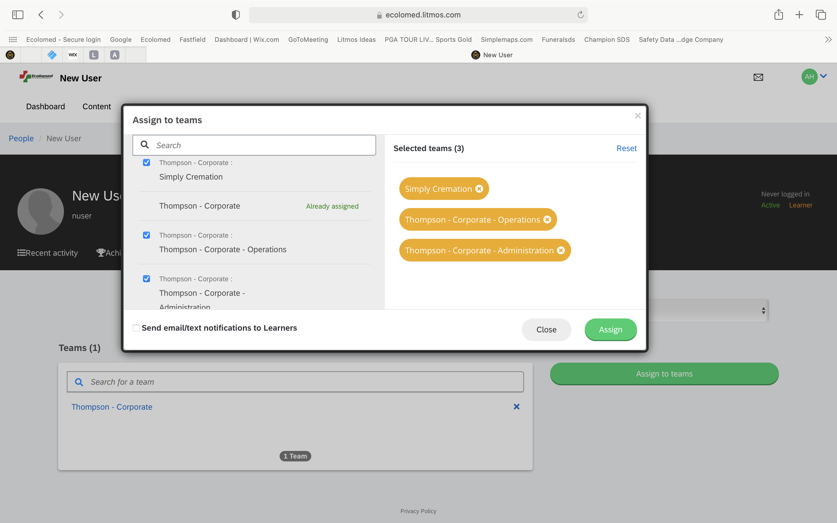
Adding an Employee
To assign employee to additional necessary teams, click “Assign to Teams”
Then designate the other necessary teams for the employee and click “Assign”

Slide 13
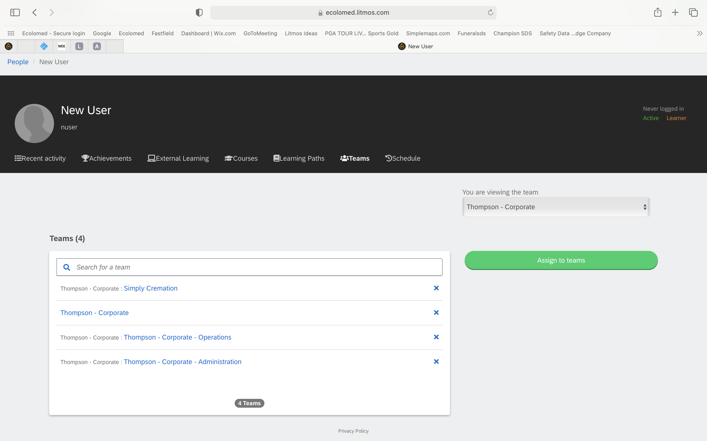
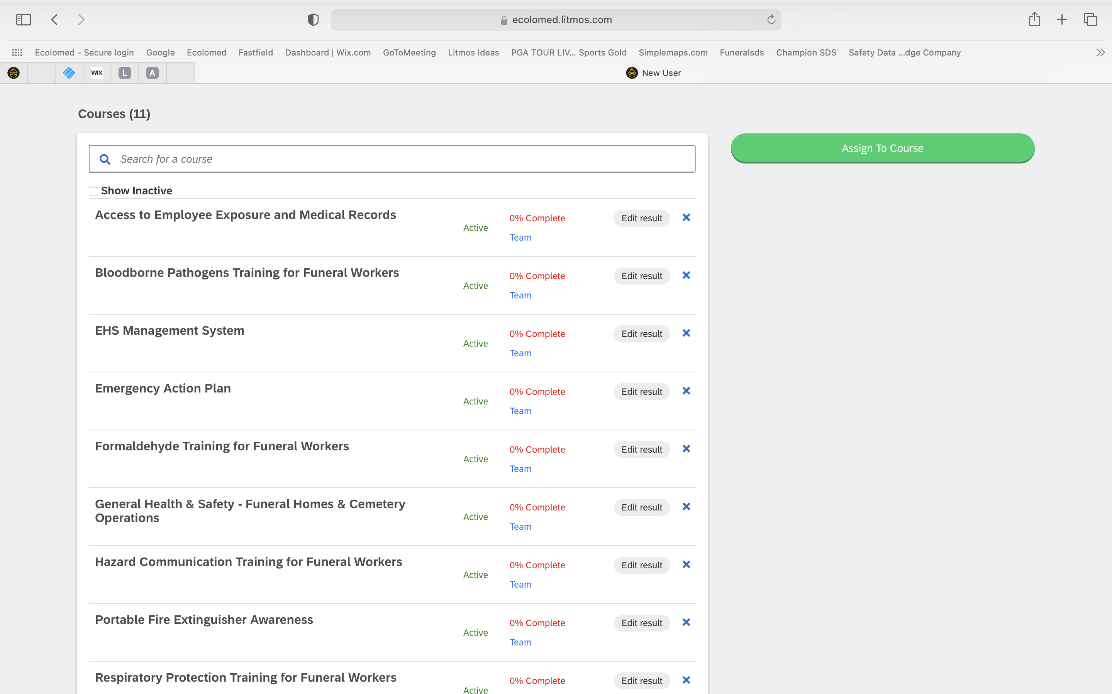
Adding an Employee
Now you can see the various teams the Employee has been assigned to
By clicking on “Courses”, you can now see the various courses the Employee has been assigned as a result of the team assignments

Slide 14
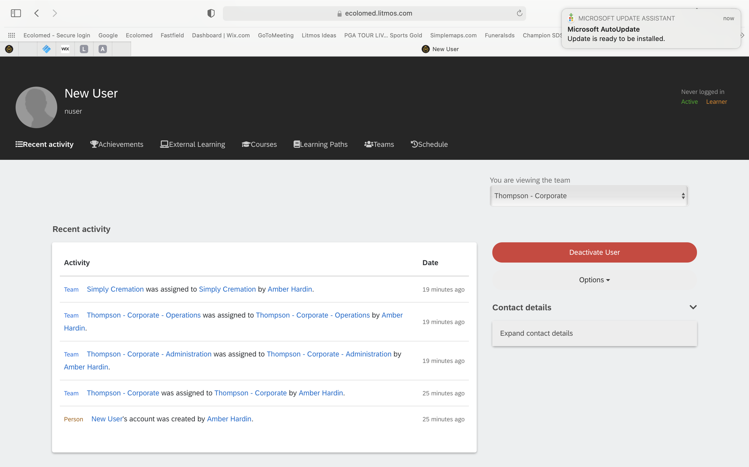
Deactivating an Employee
From your Dashboard, click on “People” tab at top of screen
Click on an employee’s name
Click on “Deactivate User” red button
Deactivated employee records are still maintained in system and may be useful to the funeral home in the future
There is a delete function in the system, but it is not recommended because all historical training records are permanently deleted and cannot be recovered

Slide 15
Managing User Access/Information
Forgotten Username
Team Admin provides employee their Username from “People” list
Forgotten Password - 2 Options
Option 1 – Use “I’ve Forgotten my Username or Password” link on login page
Option 2 - Team Admin sends a link for User to reset password

Slide 16
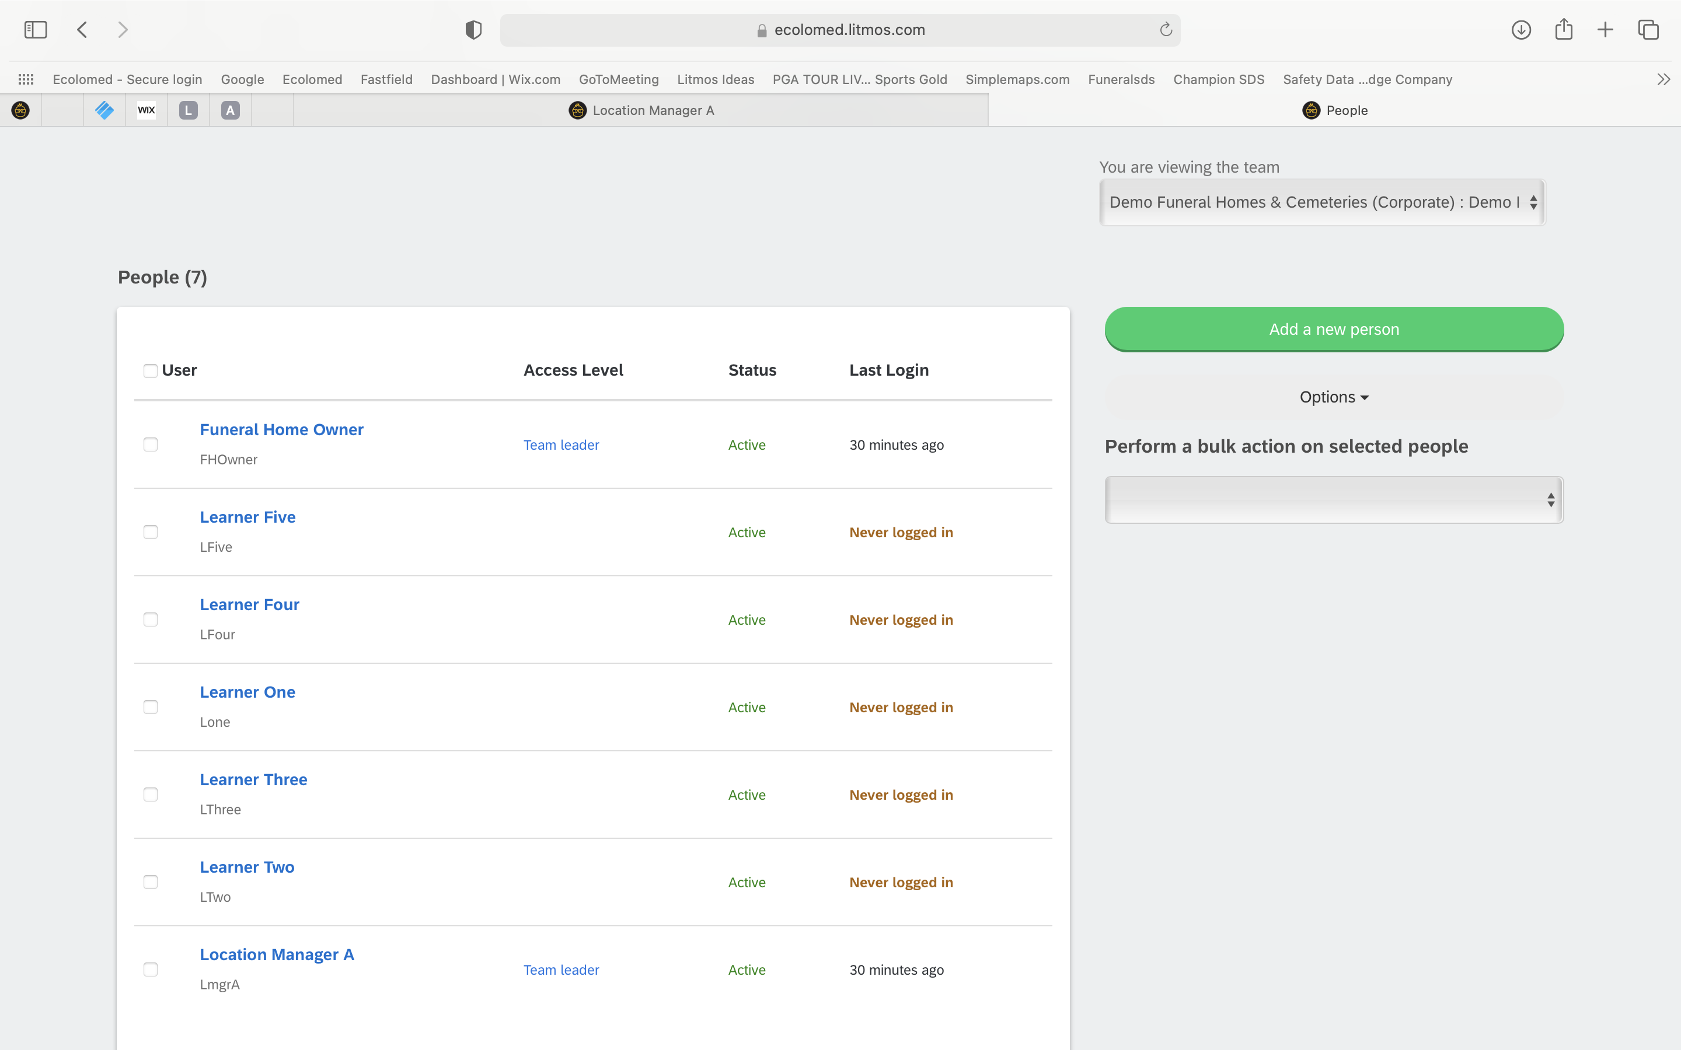
Forgot Username
To locate Username, click on “People”
Username is found under each person’s name
Provide Username to Employee

Slide 17
Forgot Password (Option 1-Preferred)
“I’ve Forgotten my Username/Password” Feature
If a user forgets their password, please have them utilize the ”I’ve forgotten my username/password” feature and system will email them a link to reset
They must know their username however to use this feature. If they don’t remember their username, then you can go to their profile to obtain their username and simply tell them
They must also have an accessible email

Slide 18
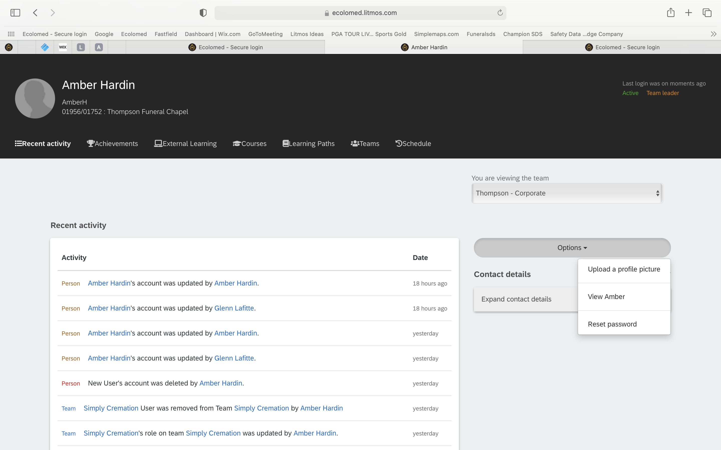
Forgot Password (Option 2)
“Send Reset Email Link”
While in an Employee’s Profile, Click on ”Options”, then “Reset Password”

Slide 19
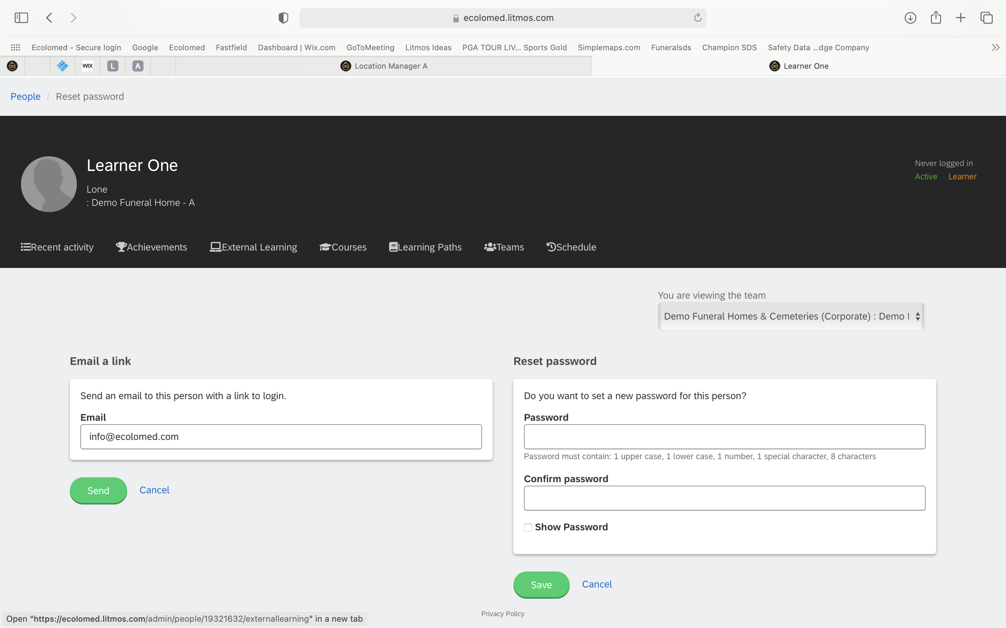
Forgot Password (Option 2)
“Send Reset Email Link”
You can assist an employee reset their password by simply sending them an email link with a hyperlink that requires them to reset their password themselves and simultaneously gives them their Username
Keep in mind the hyperlink expires after 24 hours making this option very time sensitive
The “Reset Password” manual feature on right is not recommended as the employee will still have to reset their password themselves (this is obsolete)

Slide 20
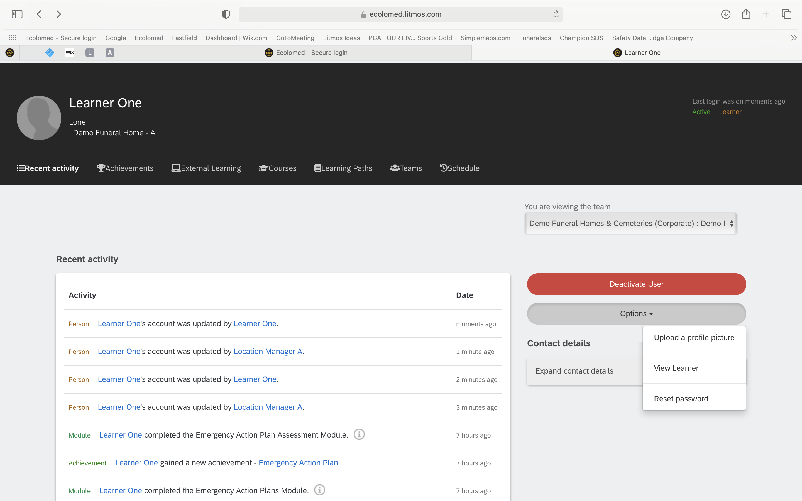
Employee Profile
Each employee has a profile containing important information
As a Team Lead, you may find the need to “edit” an employee’s profile information e.g. name, email address, username, others
Click on “View Learner”

Slide 21
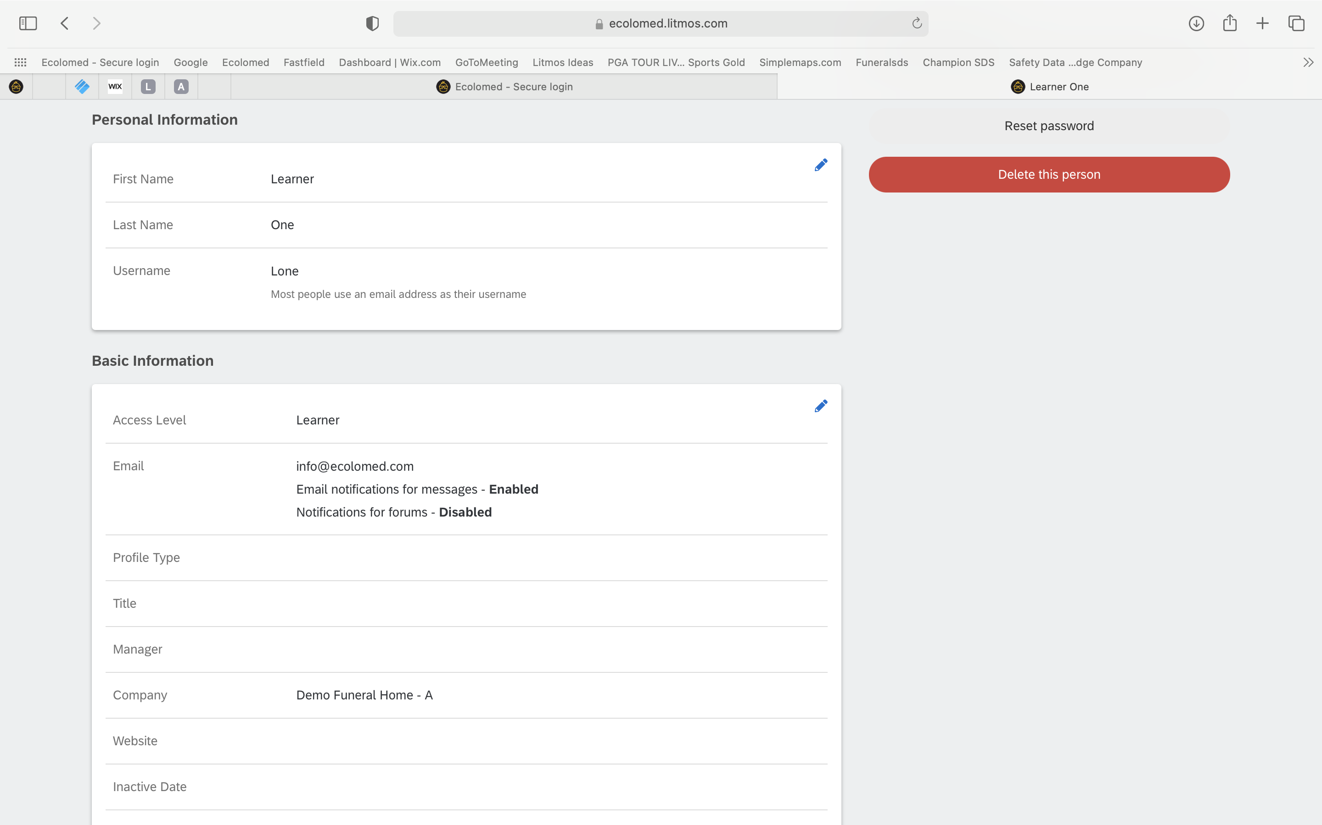
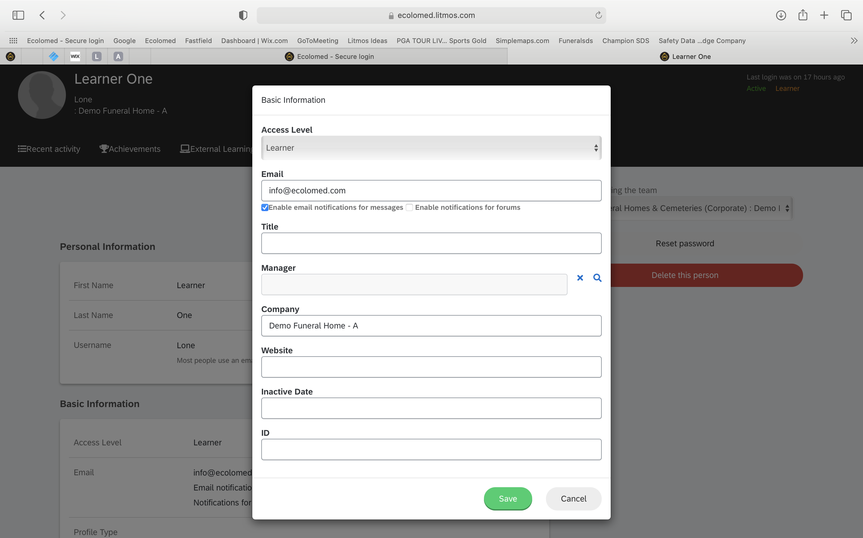
Employee Profile
To edit an employee’s profile information, click on the blue edit “pencil”
Make changes and click “save”

Slide 22
Other Helpful Information
Course Semantics (2 parts):
Review Material
Assessment
Certificate of Completion
365-day timers
Course Reminders (30 days prior to compliance expiration)
Automatic Re-assignment of Courses 30 days from compliance expiration
Cannot retake courses again until re-assigned 30 days prior to expiration
Non-Compliant after 365 days
Email reminders monthly (3 mos. Only)

Slide 23
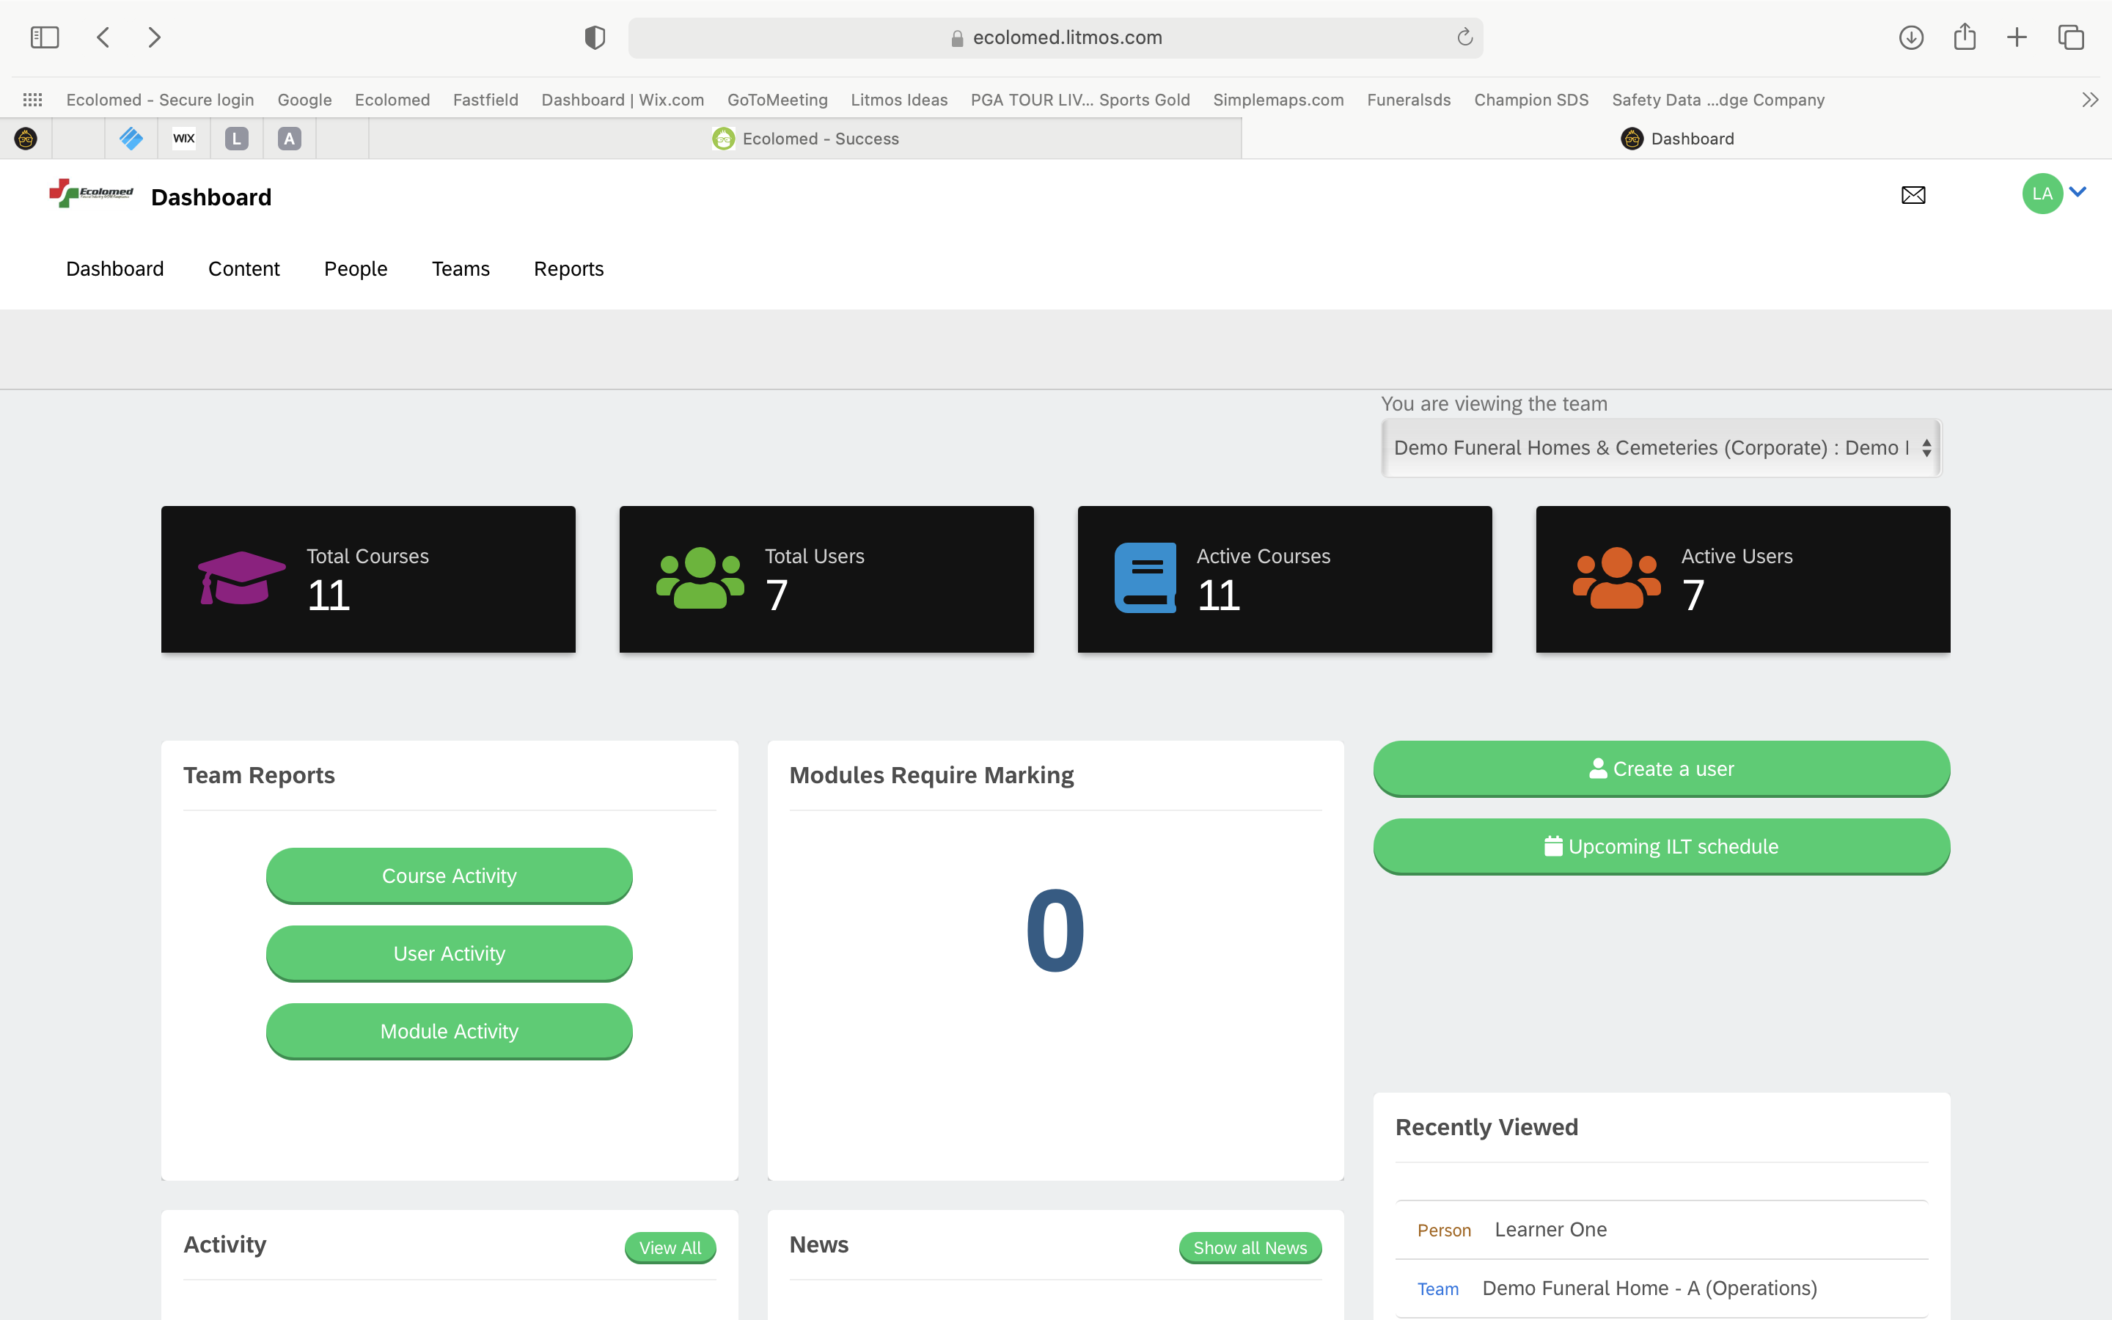
Compliance Reports
As a Team Lead, you have access to a variety of Reports that will help you monitor and manage your employee’s completion of OSHA-required training
Click on “Reports”

Slide 24
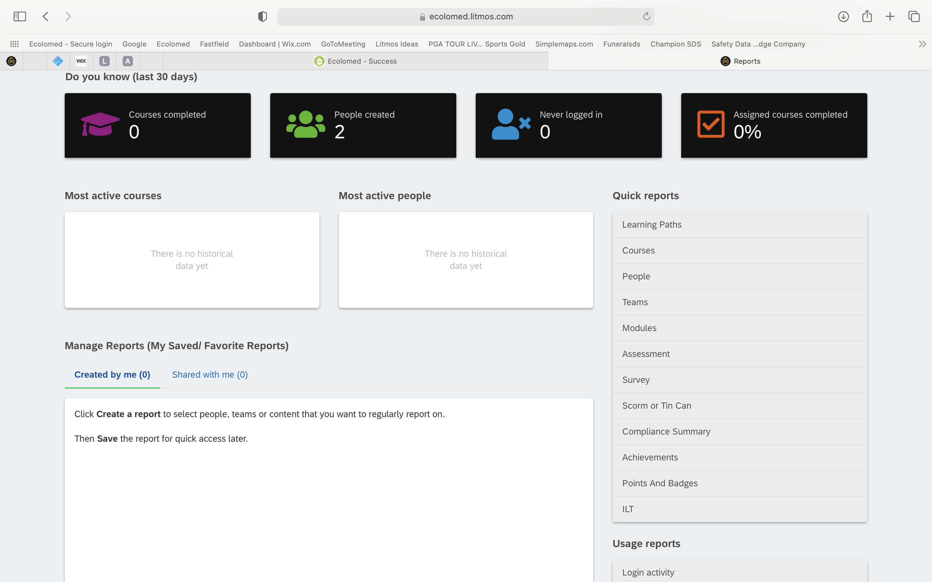
Compliance Reports
“Quick Reports” – There are a variety of different types of reports you can generate and even have emailed to you on a regular basis.
We are going to show you a few of the most helpful reports at your disposal
Click on “People”

Slide 25
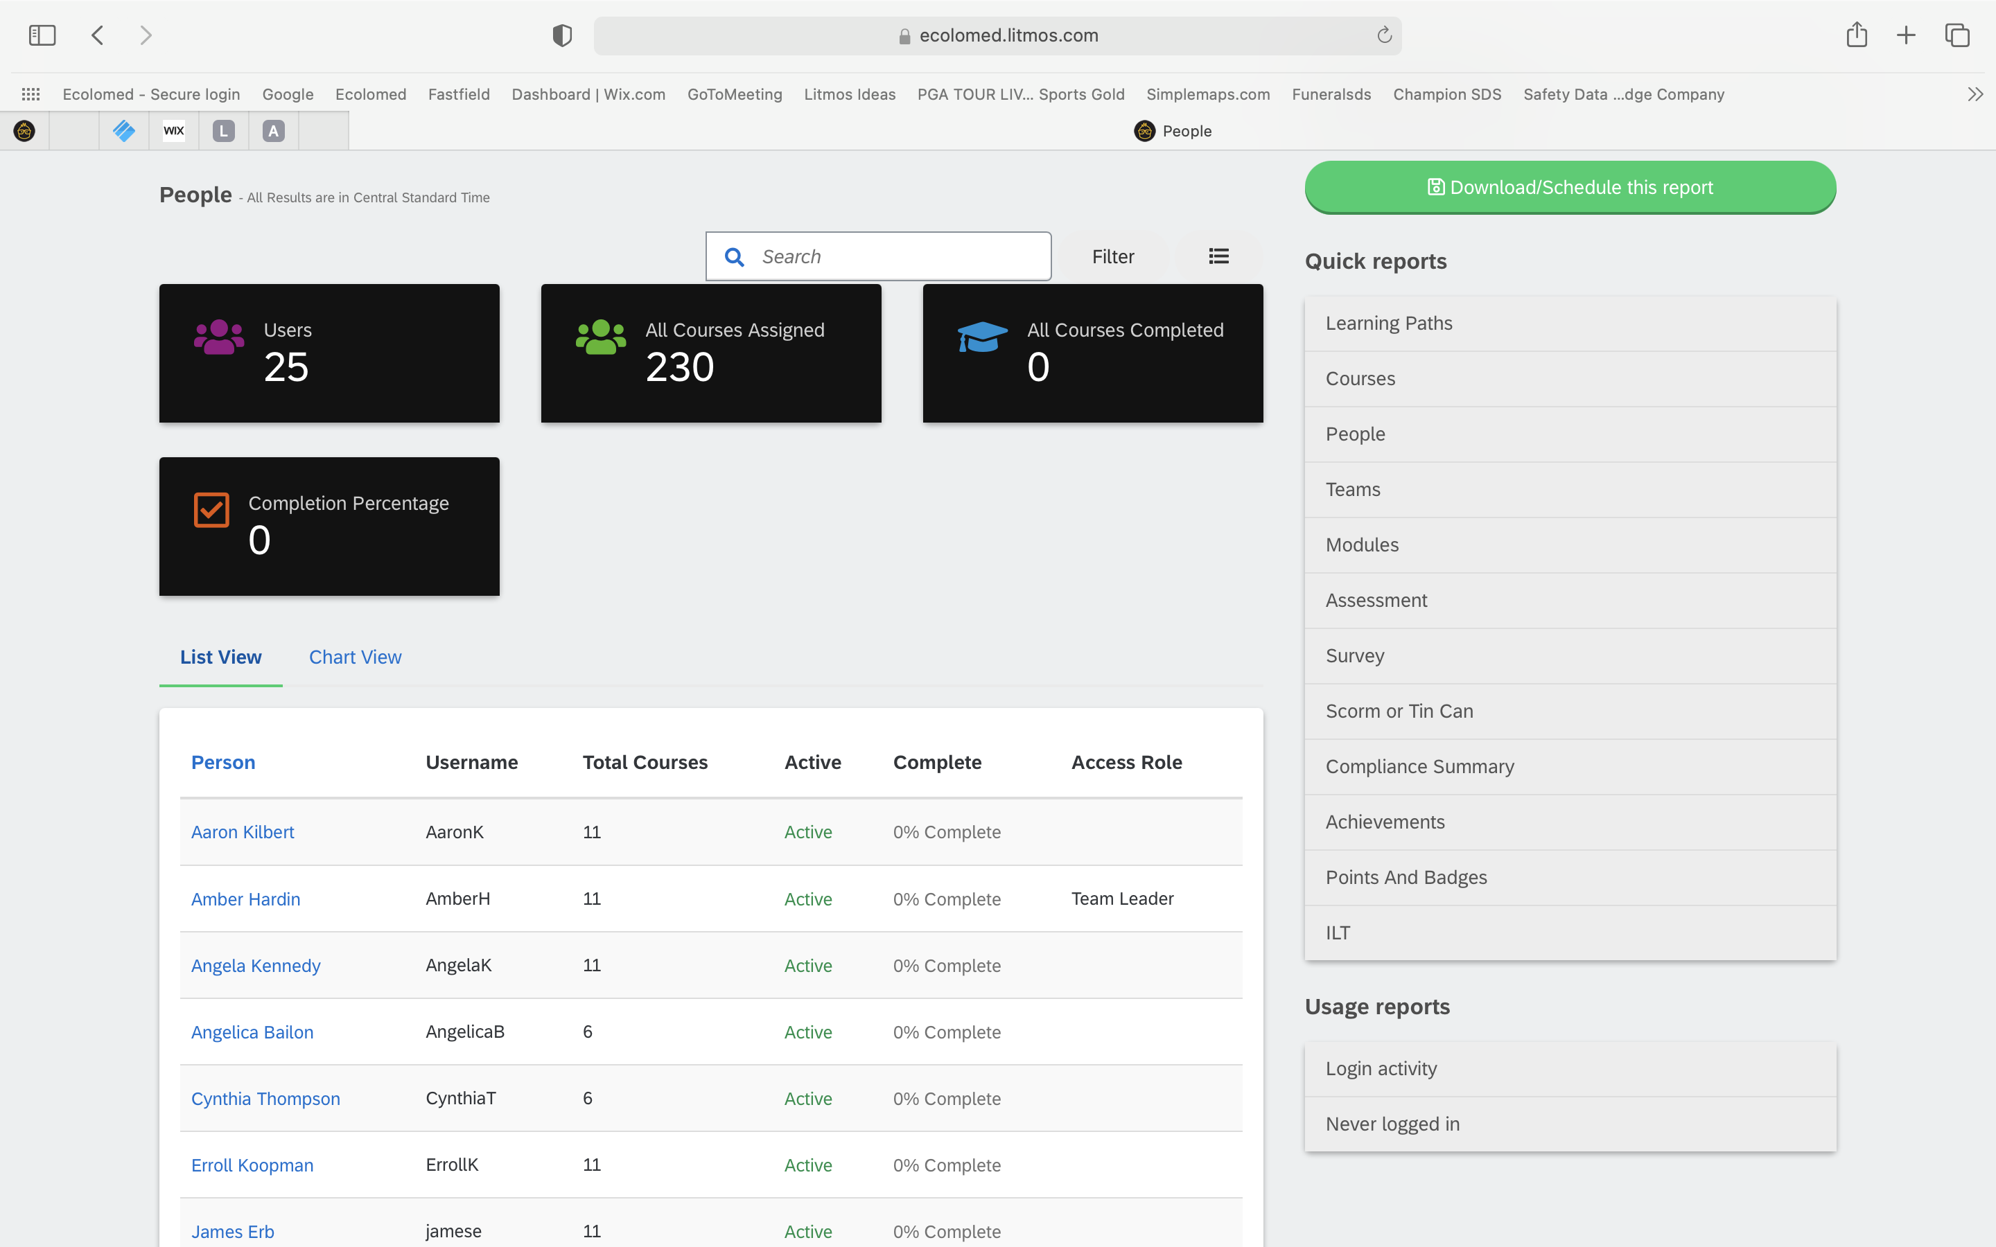
Compliance Reports
Here you see the training status of all your employees i.e. Total Courses Assigned and % Complete
This is a quick way to see where everyone is at any given time
Click on an Employee and let’s look at more detail

Slide 26
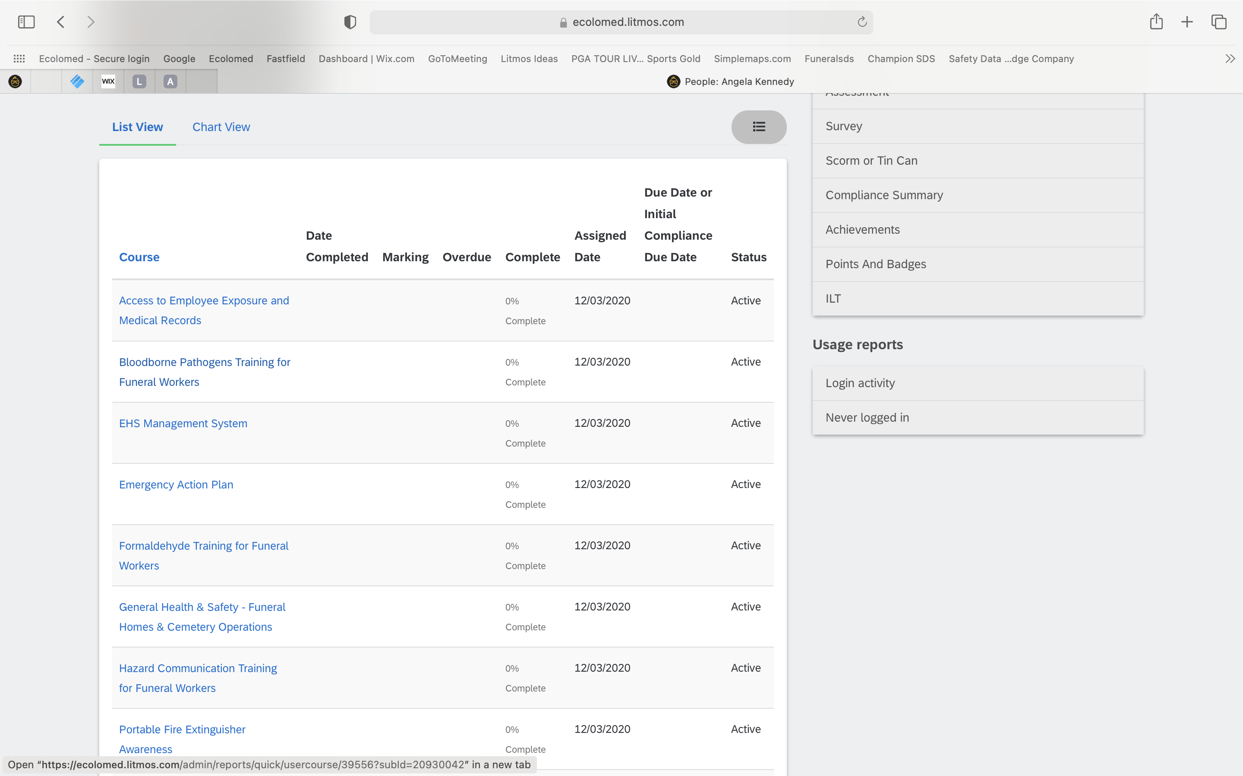
Compliance Reports
More detailed information on the Employee can be seen here
You can see courses assigned to the employee and specific completion status of all their assigned courses
Filtering information you see……….Click on 3 Dot Icon

Slide 27
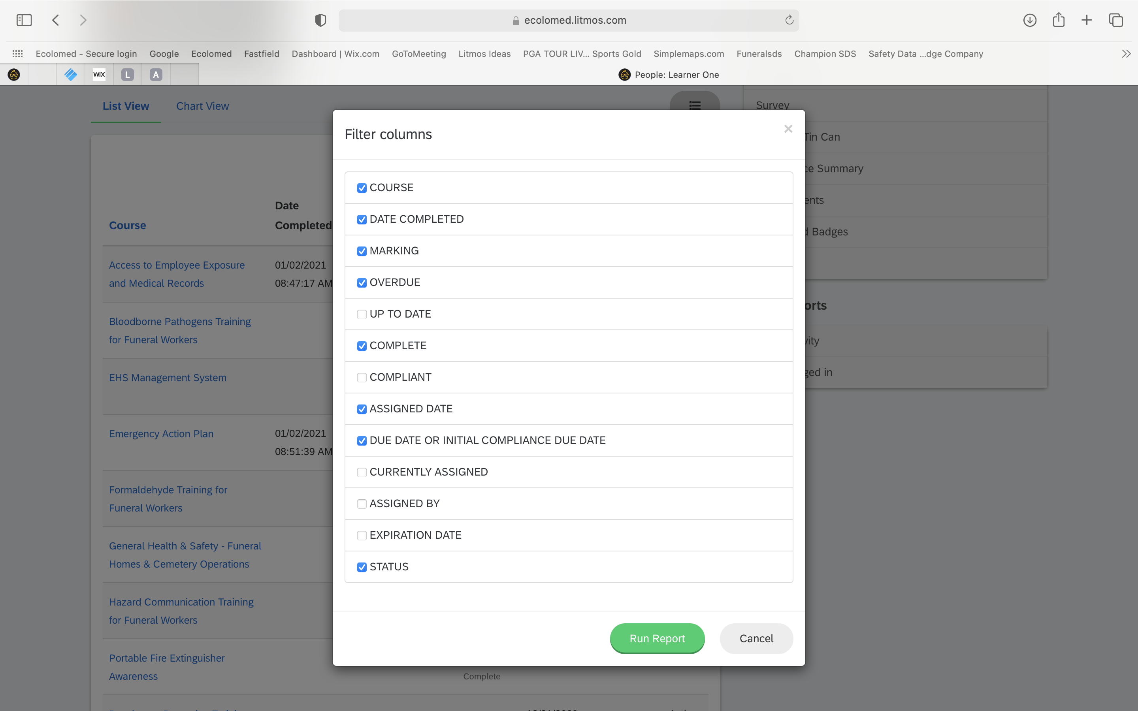
Compliance Reports
You can customize the specific types of information you want to see for a particular employee

Slide 28
Compliance Reports
Scheduling a Report
If you like seeing the overall training compliance status of all your employees, then you can have this report emailed to you on a regular frequency
Click on “Download/Schedule this Report”

Slide 29
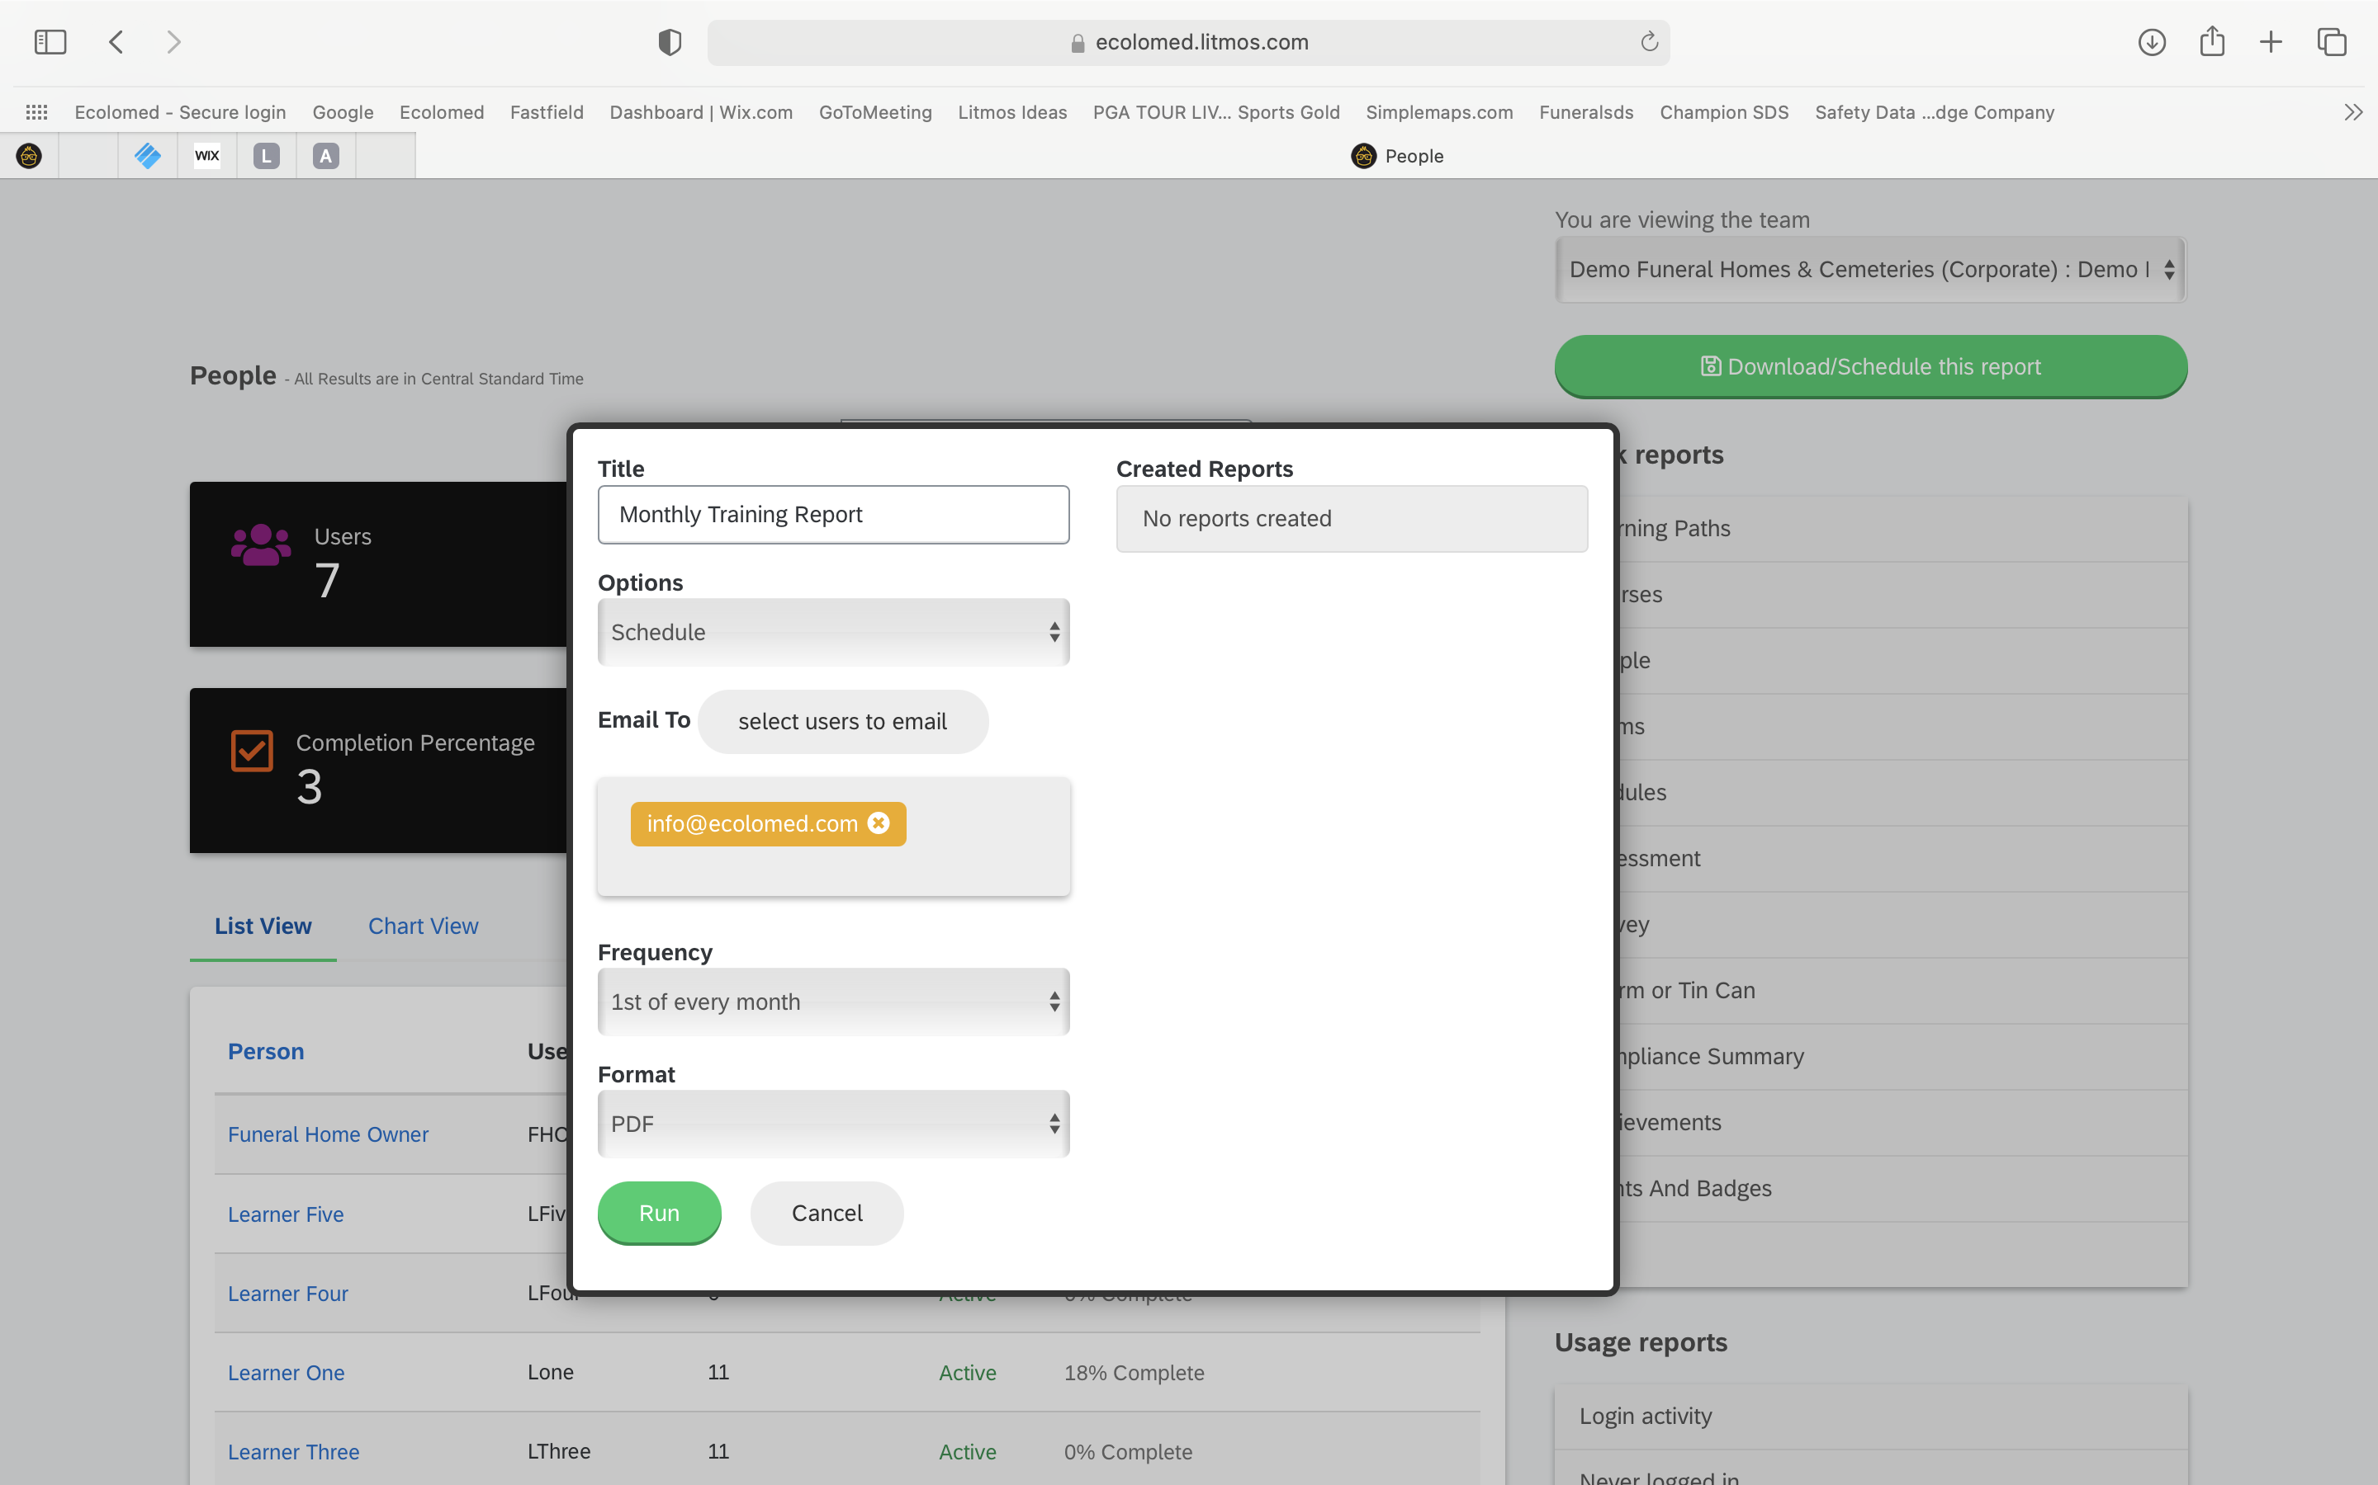
Compliance Reports
Name the Report
Schedule the Report to be sent to you or you can Download immediately
Your Email should auto-populate, but you can also add additional people to send to
Select the Frequency you want to receive the report

Slide 30
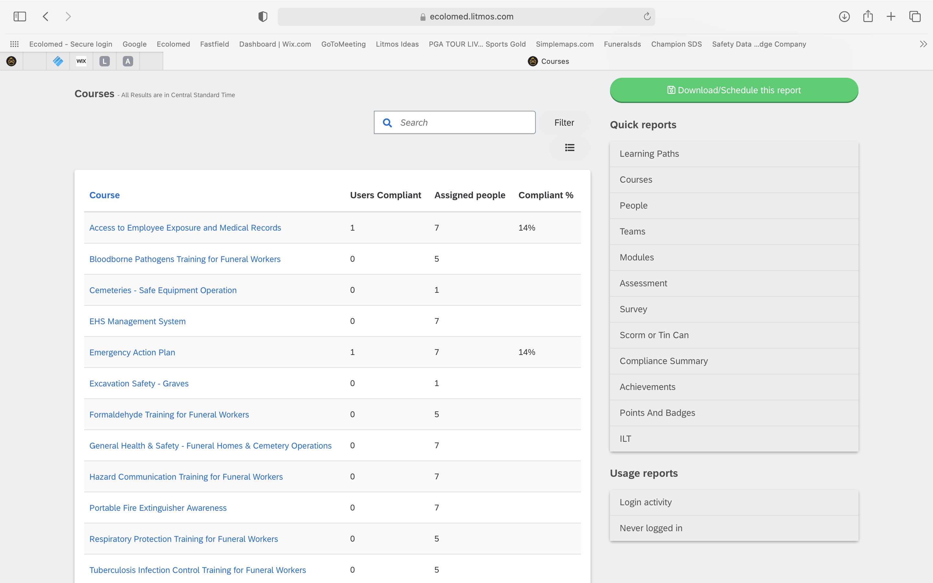
Compliance Reports
“Compliance Summary” Report is another report you may find valuable
It provides a course-by-course summary of completion status

Slide 31
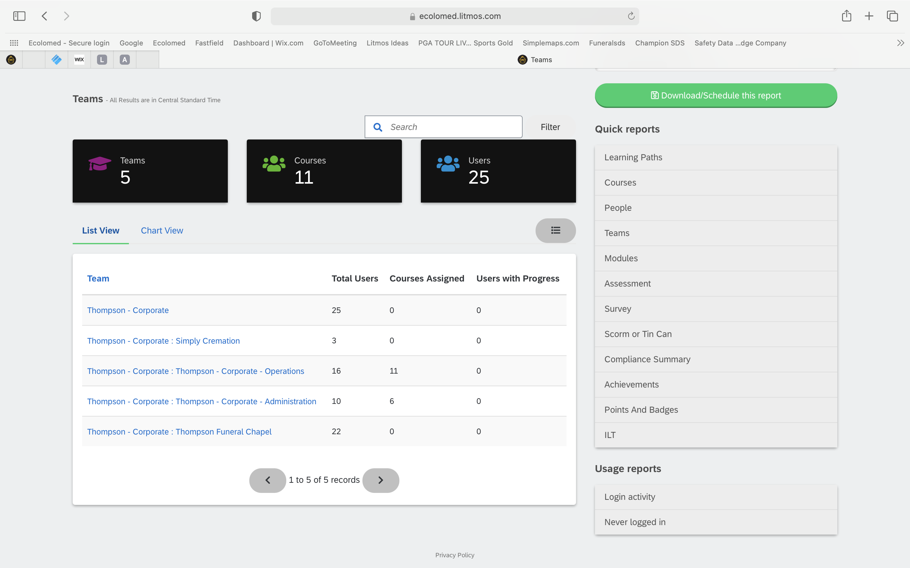
Compliance Reports
“Teams” Report” is another report you might find valuable
It shows you your Teams and a high-level accounting of where the Team stands as a whole

Slide 32
Compliance Reports
Some features of the “Quick Reports” are not used currently

Slide 33
Questions?

